Slide 1
An overview of MACSio With a focus on Multiple Independent File (MIF) Parallel I/O and ZFP Compression with the HDF5 plugin.
HDF5 User’s Group (HUG)
Mark C Miller
October, 2020

Slide 2
What is MACSio?
Multi-purpose
Application-Centric
Scalable i/o
Proxy application
Highly Flexible
High Level of Abstraction (LOA)
Parallel I/O “Workloads”
More than a “benchmark”
MACSio aims to represent workloads from real HPC applications and enable comparisons among various approaches

Slide 3
Why MACSio?
Existing tools don’t operate at LOA of real applications
Benchmarks often limited in scope
Unable to drive wide a variety of I/O loads
Specific to a particular parallel I/O paradigm
Not easily extendible
Application kernels also limited
Ignore I/O entirely
Only one specific I/O load
Only one specific I/O paradigm
Not easily extendible
MACSio aims to be
Highly Flexible

Slide 4
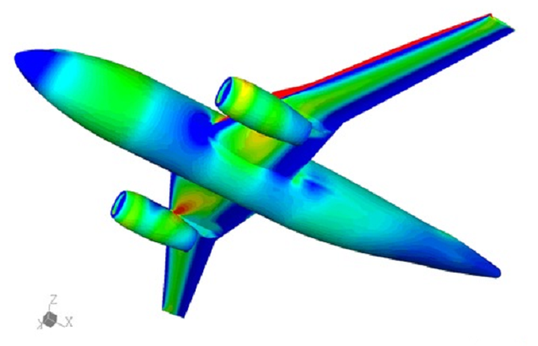
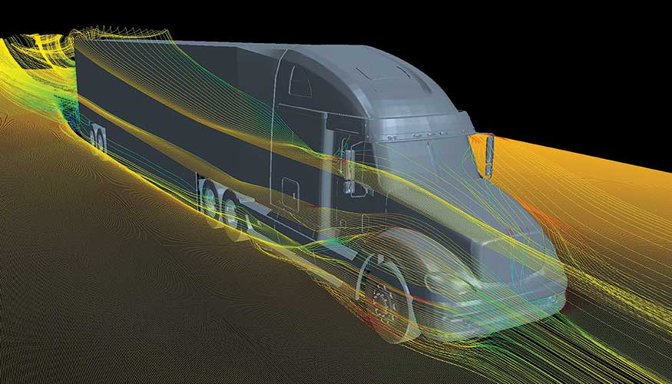
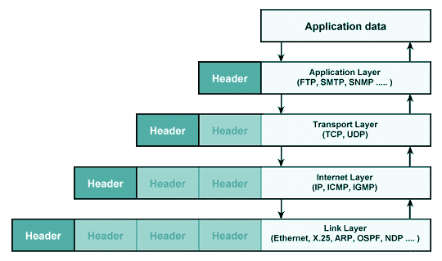
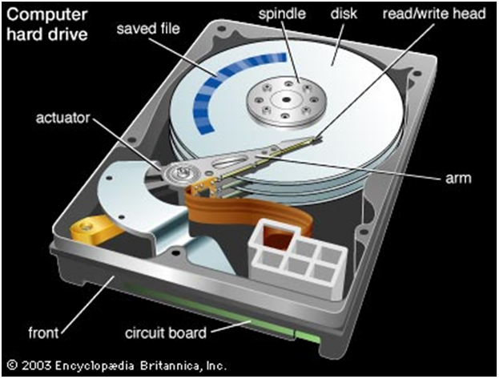
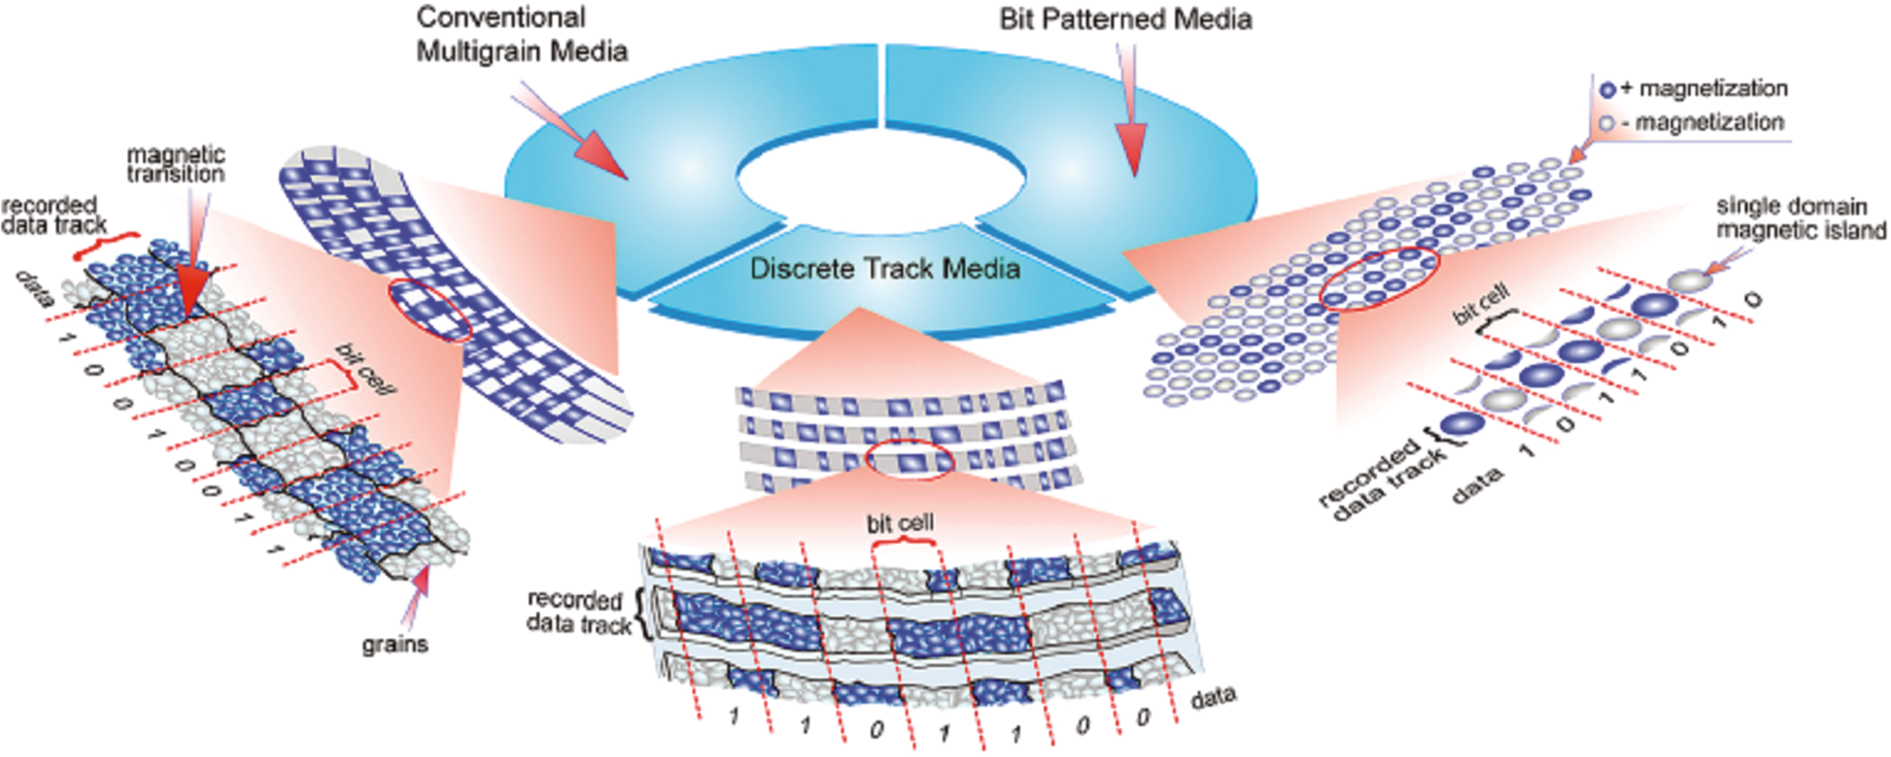
I/O, Abstraction and the HPC I/O “Stack”
unsigned char img[256][256];
int mysz=sizeof(img)/nranks, off=mysz*rank;
struct hdr_t {int nx, ny, type, fill; } hdr;
int hdrsz = sizeof(hdr);
/* go to dir in fs where we store images */
chdir(“my_images”);
/* create image file and write header */
if (rank == 0) {
fd = open("foo.dat", O_CREAT, 0600);
write(fd, &hdr, hdrsz);
close(fd);
}
MPI_Barrier(MPI_COMM_WORLD);
/* write this proc’s part of image */
fd = open("foo.dat", O_WRONLY);
pwrite(fd, &img[off][0], mysz, hdrsz+off);
close(fd);
unsigned char img[256][256];
int mysz=sizeof(img)/nranks, off=mysz*rank;
struct hdr_t {int nx, ny, type, fill; } hdr;
int hdrsz = sizeof(hdr);
/* go to dir in fs where we store images */
chdir(“my_images”);
/* create image file and write header */
if (rank == 0) {
fd = open("foo.dat", O_CREAT, 0600);
write(fd, &hdr, hdrsz);
close(fd);
}
MPI_Barrier(MPI_COMM_WORLD);
/* collectively open and write data */
MPI_File_open(MPI_COMM_WORLD, “foo.dat”, MPI_MODE_WRONLY|MPI_MODE_CREATE, MPI_INFO_NULL, fd);
MPI_File_set_view(fd, hdrsz+off, MPI_UNSIGNED_CHAR, MPI_UNSIGNED_CHAR, NULL, MPI_INFO_NULL);
MPI_File_write_at_all(fd, 0, &img[off][0], mysz, MPI_UNSIGNED_CHAR, &status);
MPI_File_close(fd);
unsigned char img[256][256];
int mysz=sizeof(img)/nranks, off=mysz*rank;
struct hdr_t {int nx, ny, type, fill; } hdr;
int hdrsz = sizeof(hdr);
/* open image database and write object */
int x0 = 0, x1 = 256, y0 = off, y1 = off+mysz;
ImgDb = ImageDB_Open(“my_images”):
ImageDB_Put(“foo”, x0,y0,x1,y1, IDB_UCHAR, fillval, img);
ImageDB_Close(Imgdb);
Example Objects
Physics, Chemistry, Materials...
PDEs, Fields, Topologies, Manifolds
Meshes, Materials, Variables
Arrays, Structs, Lists, Trees
Ints, Floats, Pointers, Offsets, Lengths
Files, Dirs, Links, Permissions, Modes
Pages, Inodes, FATs, OSTs, OSDs
Bits, Volumes, Sectors, Tracks

Slide 5
MACSio Operates at a Higher LOA
Increasing LOA
Concepts
Real World Phenomena
Continuous Mathematics
Discrete Numerical Models
Prog. Language Data Constructs
Primary Storage (Main Mem.)
File System
Secondary Storage (logical)
Secondary Storage (physical)
Objects
Physics, Chemistry, Materials...
PDEs, Fields, Topologies, Manifolds
Meshes, Materials, Variables
Arrays, Structs, Lists, Trees
Ints, Floats, Pointers, Offsets, Lengths
Files, Dirs, Links, Permissions, Modes
Pages, Inodes, FATs, OSTs, OSDs
Bits, Volumes, Sectors, Tracks
Implementations
ALE3D, Albany, LAMPS
MFEM, FiberBundles, Sheafs, SAF
Silo, LibMesh, Exodus, ITAPS, VTK
HDF5, netCDF, ArrayIO, PDB
MPI-IO, XDR, stdio, aio, mmap
POSIX IO
GPFS, HDFS, Lustre | ext2/3, zfs, xfs, hfs
hd, sd, cd, dvd, tape, ramdisk, flash
MACSio
Existing
Tools

Slide 6
Evaluation of Existing Benchmarks
LOA=Level of Abstraction
PMode=Parallel Mode
Coll=Collective I/Os
Abs Keep=Abstraction Preserving?
DIT=Data in transit services
precision, cksum, compress, subset...
EZ-Extend (how hard to add)
Parallel Mode, I/O library, X in MPI+X
Dir & FS ops
fstat, opendir, readdir, unlink
Perf DB=Performance Database

Slide 7
Flexibility in Parallel I/O Paradigms
Variations
Burst Buffers
Collective vs. Independent
Segmented vs. Strided
Two Phase
I/O node affinities
Custom I/O node code
Extra nodes just for I/O
File Per Processor (FPP)
Multiple Independent File (MIF)
Single Shared File (SSF)
Mutiple Indep. File 0
Single Shared File
P0
P1
P2
P3
P4
Mutiple Indep. File 1
P0
P0
P1
P2
P3
P4
P1
P2
P3
P4
Proc File 0
Proc File 1
Proc File 2
Collective
Proc File 3
Proc File 4
FPP (N:N)
SSF (N:1)
(strided shown)
MIF (N:M)
Independent

Slide 8
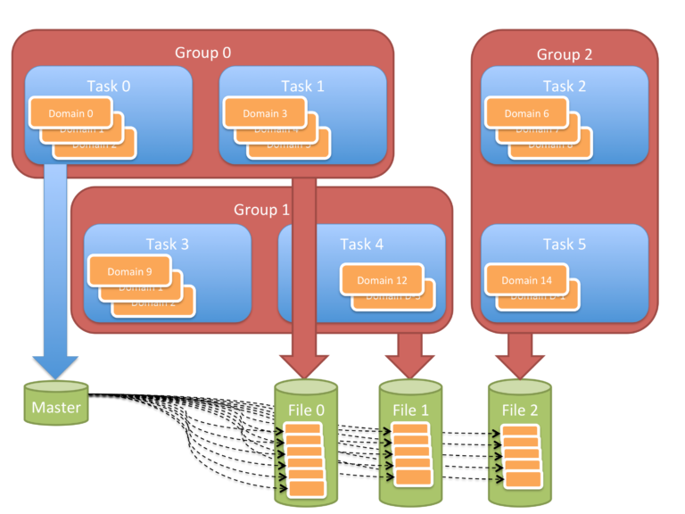
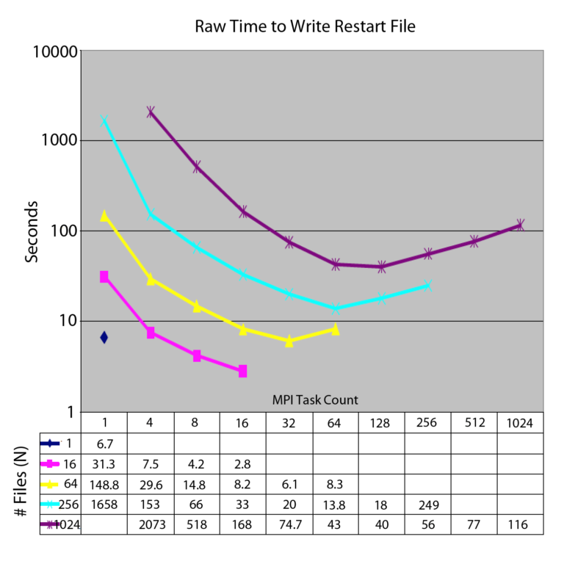
MIF in Detail
Serial within Groups
Concurrent across Groups
#Files = #Groups ≠ #Ranks
FPP ➔ Group size == 1 Rank
Changing #Ranks from run to run
Concurrency managed by app
Simpler I/O model/coding
Works with serial I/O library
Easy/Simple Throttling
Equiv. to MongoDB Shards

Slide 9
MACSio Architecture
MACSio Main
Uber JSON Object
Uber JSON Object
File System Ops
Compute/Comm Activity Gen
Mesh + Field Data Generation
Parallel I/O Mode Manager
Dump R/W Sequencing
Performance Data Collection
Burst
Write
HBase DB
Trickle
Write
Timing, Control
& Event Logging
Trickle
Read
Burst
Read
I/O Library Plugins
Uber JSON Object
On-Disk DBs
In-Mem DBs
HDF5
MFEM
Exodus
LibMesh
Silo
ITAPS

Slide 10
HDF5 Plugin
MIF and SSF
Collective or Independent Requests
Compression methods
Deflate, szip (builtins)
Zfp (plugin)
Importance of “realistic” data
Default Layout CONTIGUOUS
Checksums
MD Cache Config settings file

Slide 11
MACSio’s Main Data Object
"Mesh": {
"MeshType": "rectilinear",
"ChunkID": 0, # unique per part
"GeomDim": 2,
"TopoDim": 2,
"LogDims": [50,100],
"Bounds": [0,0,0,1,1,0],
"Coords": {
"CoordBasis": "X,Y,Z",
"XAxisCoords": [...],
"YAxisCoords": [...]
},
"Topology": {
"Type": "Templated",
"DomainDim": 2,
"RangeDim": 0,
"ElemType": "Quad4",
"Template": [0,1,51,50]
}
},
"Vars": [
{...},
{...},
{
"name": "spherical",
"centering": "zone",
"data": [...]
},
{...},
{...},
{...}
],
"GlobalLogIndices": [...],
"GlobalLogOrigin": [...]
}
An Uber JSON-C Object

Slide 12
Easily and Independently Test. . .
Strong / Weak Scaling Studies
Physically relevant data, Not all zeros/random()
I/O libraries (plugins)
I/O Paradigms (helper modules)
Data Validation
Data-in-Transit services
Variety & mix of I/O loads
Time & Space Performance
In combination with other tools
Mesh part size & # parts/rank
Variable exprs + noise, Vary size, shape across ranks
Plugins: HDF5, Silo, Exodus...
SSF, MIF, FPP, coll./indep.
Use plugin reader + cksums
Prec. conv., compress, cksum, etc.
Burst / trickle dump sequencing
Built-in timing and logging classes
SCR, VisIt, Darshan, Caliper

Slide 13
Recent Success: Identified & Improved Single-Node Peak Memory Usage
Placed $120K Contract with The HDF Group To Further Improve Peak Memory

Slide 14
MACSio Examples (Silo) Visualized with VisIt
4 processors, avg_num_parts = 2.5, tot = 10 parts
Showing block decomp, spherical var + 2 vars w/Perlin noise

Slide 15
2048 Core Example on Vulcan

Slide 16
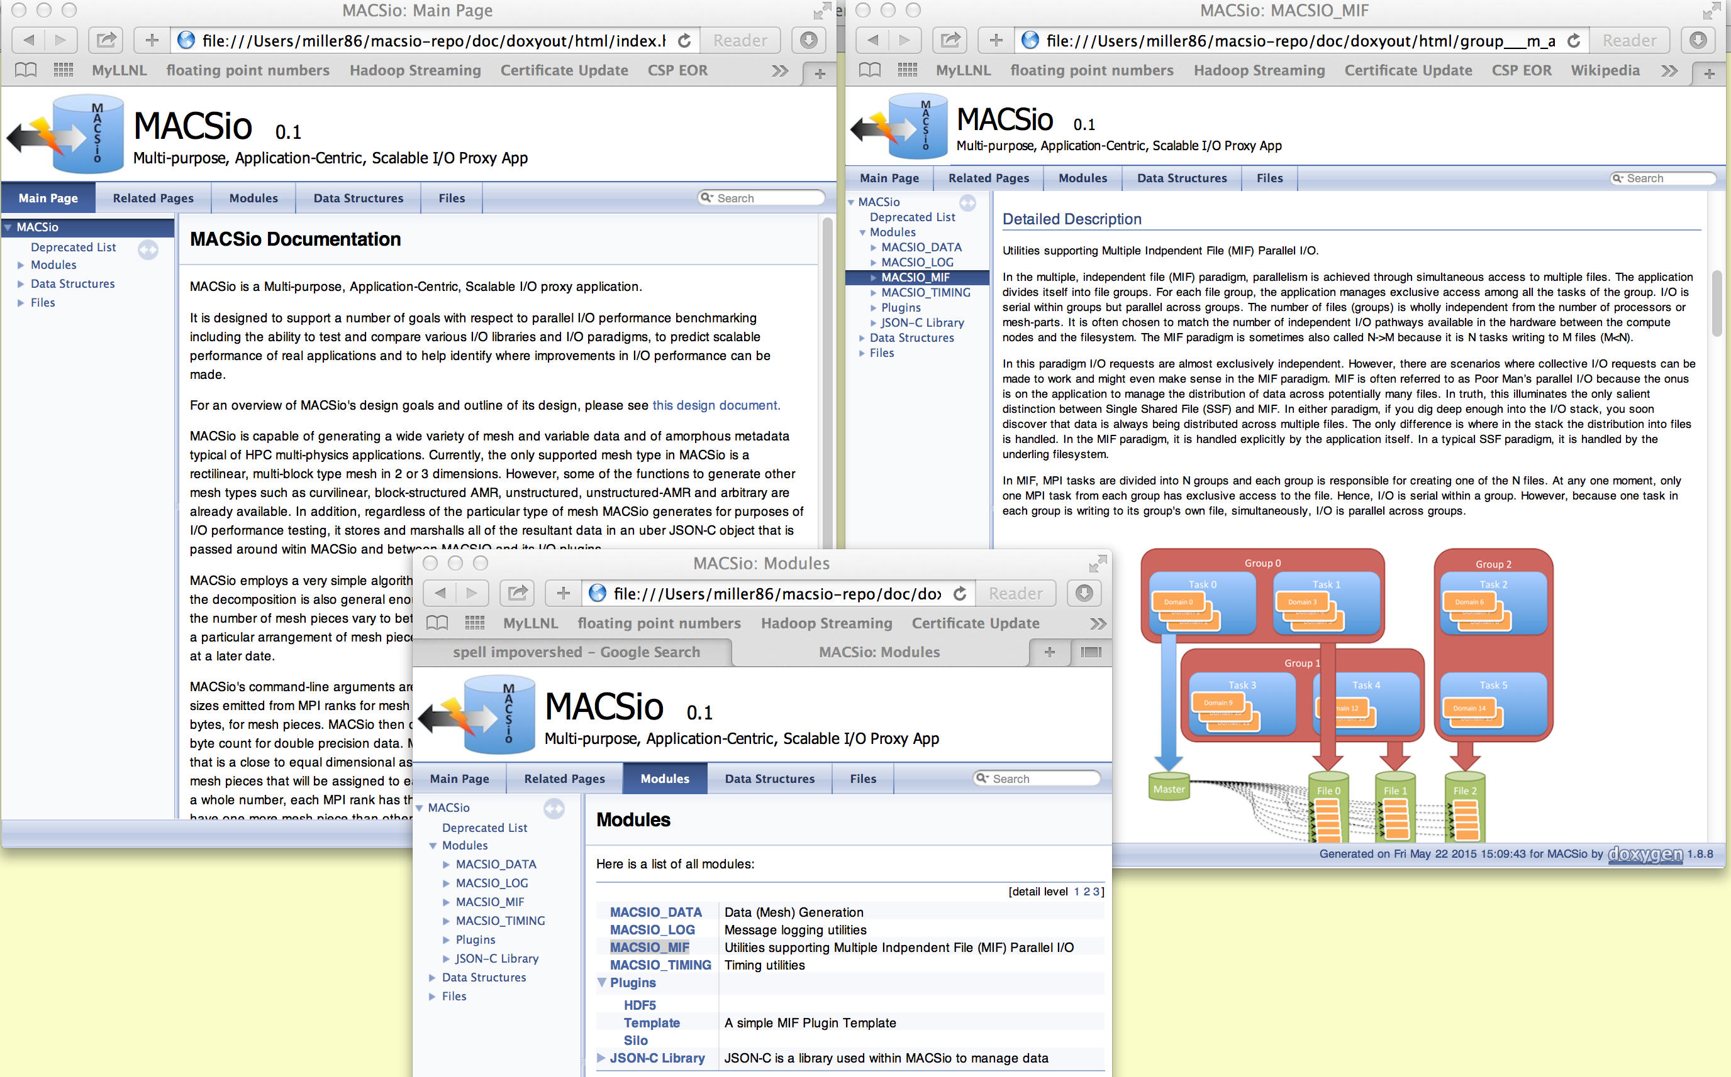
Getting MACSio
Currently all C and uses GMake
MACSio main + utils: ~4500 lines
Silo: ~900, HDF5: ~600, Exodus: ~600
Doxygen documented
GPL Open Source, on Github
https://github.com/LLNL/MACSio
Volunteers for new plugins?
AWE added a TyphonIO plugin
Contact: miller86@llnl.gov

Slide 18
Files are so four decades ago...
“POSIX IO Must Die!”
Jeffery Layton, Linux Magazine, March 2010
Oft used rational for replacing file systems with object stores
POSIX File Semantics
Sequential consistency, Atomicity, ...
Locking used to implement these hurts!
POSIX File Interfaces
stat, open, read, write, seek, close
Our workflows operate everywhere, Laptop to LCF, on these interfaces
Ginormous effort to replace!
By all means, let the semantics die!
But interfaces and files are here to stay

Slide 19
Easily and Independently Vary Test Parameters For...
Weak / Strong Scaling Studies
I/O Hardware Architecture
Burst Buffers
I/O & Compute Node Affinities
File system interfaces
Different I/O libraries (plugins)
Silo, Exodus
HDF5, Xdmf, Adios...
Data-in-transit (DIT) services
transpose / re-order
compression
checksumming
precision conversion
Parallel I/O paradigms
N:1, N:M, N:N
Strided/Segmented,
Collective/Independent
Two-Phase
Application Data Objects
Structured, Unstructured, AMR, Arbitrary Polyhedral meshes
Scalar, vector, tensor variables
Mixing Materials and subset vars
Integrate with external tools
SCR
Darshan
VisIt / Paraview

