Slide 1
The Allotrope Framework
HDF EU Workshop, 18th Sep 2019

Slide 2
Contents
What is Allotrope?
What is the Framework?
What’s the architecture?
How can it be used?

Slide 3
What is Allotrope - background
The Allotrope Foundation formed in 2012
A consortium comprised of pharmaceutical, biopharmaceutical, and other scientific research-intensive industries
A partner program for related instrument and software vendors, academic and government institutions
Primary goal is to improve data access, interoperability, and integrity across the industry via standardization
Notes:
A little background on the Foundation, to clarify where we’re coming from…
Formed out of IQ Consortium, based on the idea of GSK’s James Roberts

Slide 4
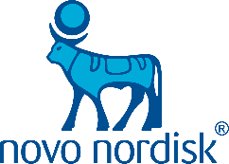
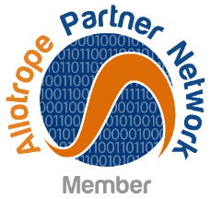
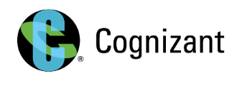
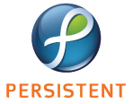
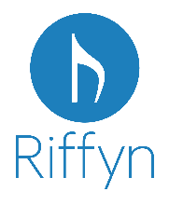
The Allotrope Community Today
BSSN Software • Cambridge Semantics • Elemental Machines • Erasmus MC • Fraunhofer IPA • L7 Informatics Mettler Toledo • NIST • Stanford University • University of Illinois at Chicago • University of Michigan • University of Southampton
Notes:
As you can see, we have wide membership from both pharma and vendor communities, as well as ties to academic and government bodies.

Slide 5
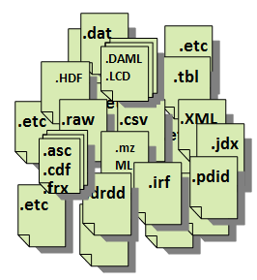
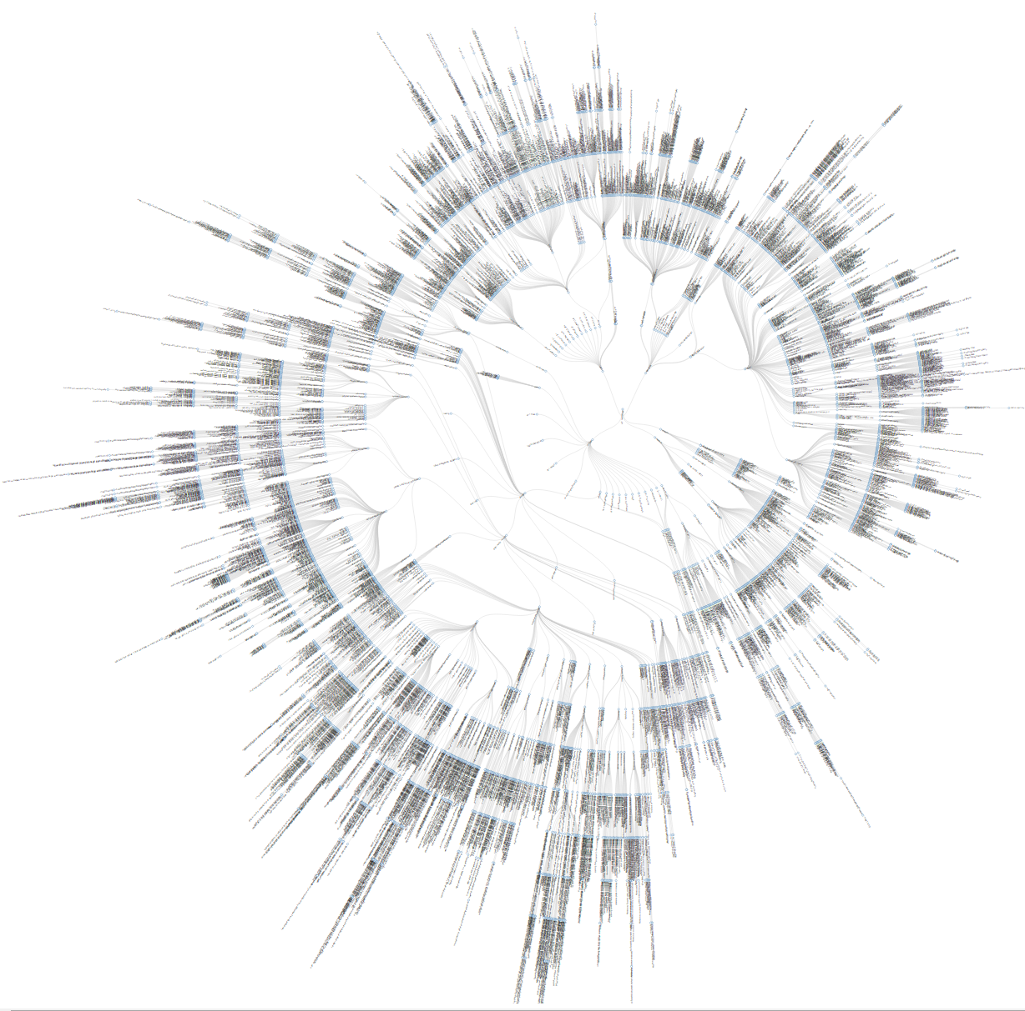
Allotrope approach - Addressing the root causes
Vendor/instrument-Specific Formats
Data in Standard Format
Paper-based and unstructured text for methods, regulations, recipes, observations, etc
A Standard vocabulary & metadata structure
Process Material Equipment
Result
Notes:
The root of the problem is the absence of standards in the current laboratory software environment.
Substantial funds are invested into treating the symptoms of our data management problems
We patch local gaps in the software, fix specific problems, and investment in large integration efforts,
But are left with the fundamental, underlying root problems
Lack of standard data format: Each instrument may have its own format created. Conversion is needed in order to read the data.
Lack of standards for metadata: The contextual metadata describing analytical methods, instruments, processes, and even the reasons for doing an experiment are inconsistent, incomplete, and often spread over multiple applications in the analytical workflow
Lack of standard interface between software applications: Finally, because the software we use across the analytical workflow is often from different sources, they are written using different technologies, and read and write different formats, so don’t often talk to one another without a custom integration effort

Slide 6
What is the Allotrope Framework?
A standardised vocabulary for data & metadata with machine-interpretable meaning
Ontologies
Allotrope Data Format
API
ADF Explorer
Data Description
Semantic Model
Data Cubes
Universal Data Container
Data Models
Data Package
Virtual file system
A set of constraints on the semantic metadata using data shapes.
A high-performance binary data format.
Instrument, vendor, platform agnostic.
An API to allow consistent creation & reading of ADF files.
ADF Explorer allows browsing of existing ADF files.
Notes:
API provided as a reference example
JCAMP workshop where no vendor could read/be read by any other vendor due to differences in implementation of the “standard”
Discuss AFO and ADM briefly, focus on LCUV

Slide 7
What is the Framework - Products
Allotrope Data Format (ADF) – first release June 2017
Allotrope Foundation Ontologies (AFO) – first release Dec 2017
Allotrope Data Models (ADM) – first release of LCUV Dec 2018

Slide 8
Allotrope Foundation Ontologies
Suite of ontologies aimed at different domains in life sciences
Based on the Basic Formal Ontology, an upper ontology widely used in other biomedical ontologies
Formal, machine-interpretable semantics enable programmatic inference of new facts from existing data
Provides consistent terms for describing data
Notes:
Using the same upper ontology enables reuse and interoperability, both between Allotrope domains and external ontologies.
Upper ontologies also tend to ensure better consistency and maintainability in the long term.
Well-crafted ontologies with formal semantics can be analysed by reasoner tools to inter

Slide 9
Allotrope Data Models
Set of standard data models supporting different technique domains
Data is represented in a flexible RDF graph structure rather than a tabular or relational form
Allotrope ontology terms are used to describe metadata and the relationships throughout
Structure can be programmatically validated via SHApe Constraint Language (SHACL)
Provides a coherent structure, independent of software or hardware vendor, to enable cross-compatibility and ensure completeness of data capture

Slide 10
Allotrope Data Models Example
This is the provisional Allotrope Data Model (ADM) for LCUV results

Slide 11
Allotrope Data Format
A file format, based on the HDF5 format, to store scientific data in a performant, consistent, self-describing way
Three core layers:
Data cubes: high performance storage for raw data
Data description: semantic graph storage for metadata
Data package: virtual file system for ancillary files
Also has built-in checksums and an audit trail, to ensure data integrity (critical in a regulated industry)
Notes:
Data cubes optimized for fast access and searching for slices in multidimensional data. Based on W3C’s RDF Data Cube standard.
Data description a new layer of storage specifically for semantic graphs. Links to data cube and data package.
Data package just like a ZIP file, can store files inside.
Optional audit trail and checksums ensure data can’t be modified invisibly
Regulatory bodies require data preservation for decades; sometimes 60+ years

Slide 12
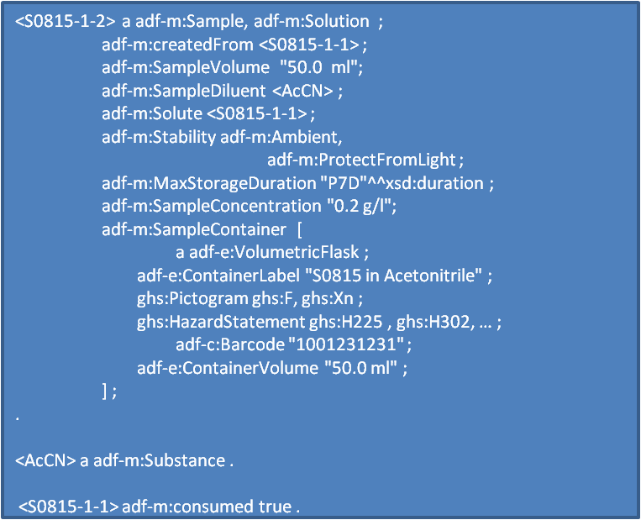
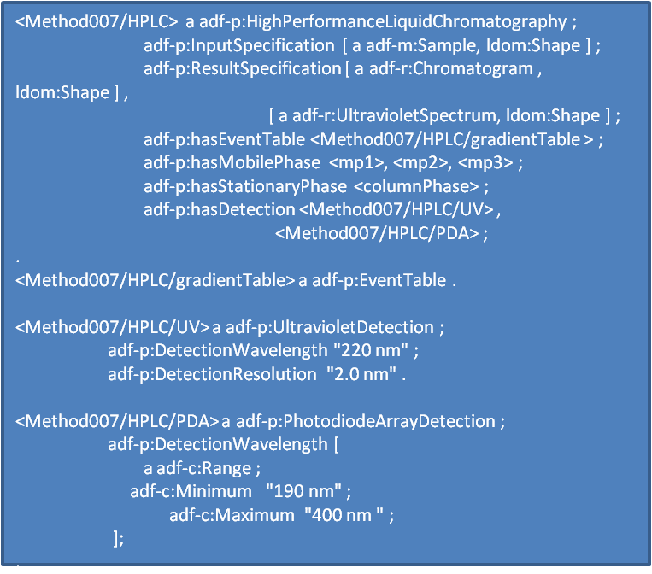
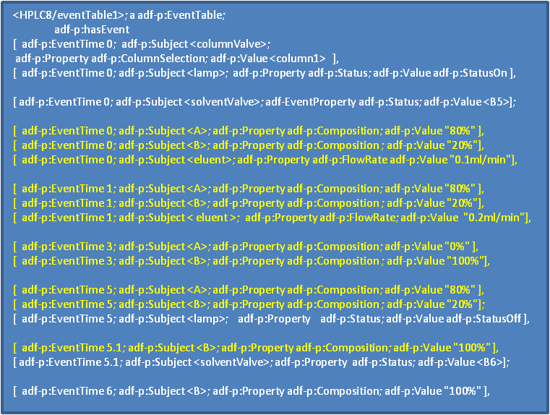
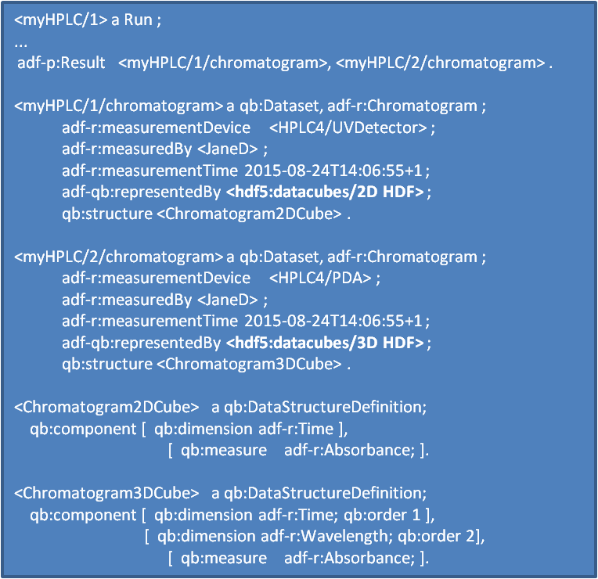
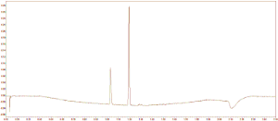
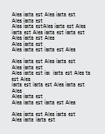
Allotrope Data Format Example
Platform Independent File Format
Data Description
Request
Sample
Method
Run
Data & Results
Data Cubes
Chromatogram: 2D
Chromatogram: 3D
Chromatogram 2D HDF
Chromatogram 2D HDF
Data Package

Slide 13
ADF Architecture
Allotrope provides libraries to access ADF in Java and .NET
The Java libraries sit on top of the native HDF library, and add ADF-specific functionality such as audit trails, as well as enforcing the ADF structure inside the HDF files
.NET libraries are transpiled from the Java libraries to maintain a consistent codebase

Slide 14
ADF API Architecture
Notes:
Agilent were closely involved in creation of the LCUV model so the internal representation is not far off the official model already

Slide 15
ADF – Internal Structure
Each of the three ADF layers is a top-level group in the HDF file
data-package
data-cubes
data-description
Auxiliary features are also stored as top-level groups in HDF
audit-trail
named-graphs

Slide 16
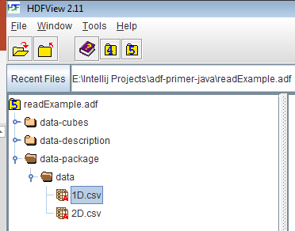
ADF Structure - Data Package
ADF uses a top-level data-package group to hold the filesystem layer
Beneath this, folders are represented as HDF groups and files as HDF datasets
Key metadata about individual files and folders are stored in the Data Description automatically by the ADF API

Slide 17
ADF API - Data Package
ADF API encapsulates this structure and presents an object-oriented interface to users
DpFiles and DpFolders classes enable read and write of the Data Package layer
ADF API provides flags for some key HDF features like compression for data storage efficiency

Slide 18
ADF Structure - Data Cubes
W3C provides an RDF Data Cube specification, for storing multi-dimensional data in a way that works with Linked Data approaches
Also compatible with the ISO SDMX standard
ADF leverages this specification for storage of the raw (and sometimes processed) data generated by scientific instruments

Slide 19
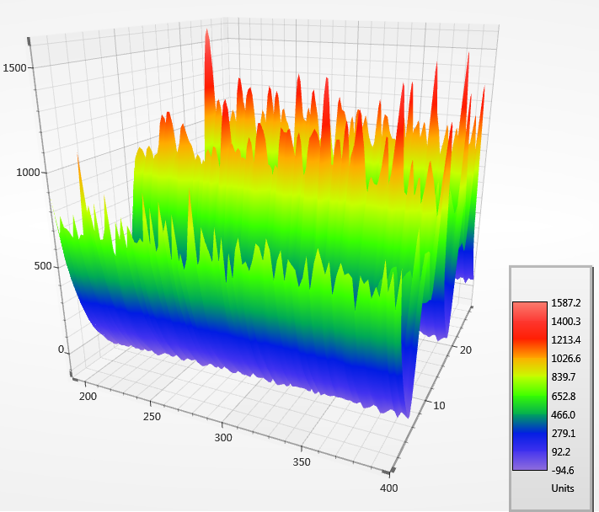
ADF Structure - Data Cubes
RDF Data Cubes consist of measures, dimensions, and scales
Measures are the observed values for a given dataset, e.g. intensity or m/z
Dimensions are the controlled variables e.g. time or wavelength
Scales are the values of the dimensions, which may be linear, nonlinear, or entirely arbitrary
All three are referenced in the data description such that metadata can be linked to them

Slide 20
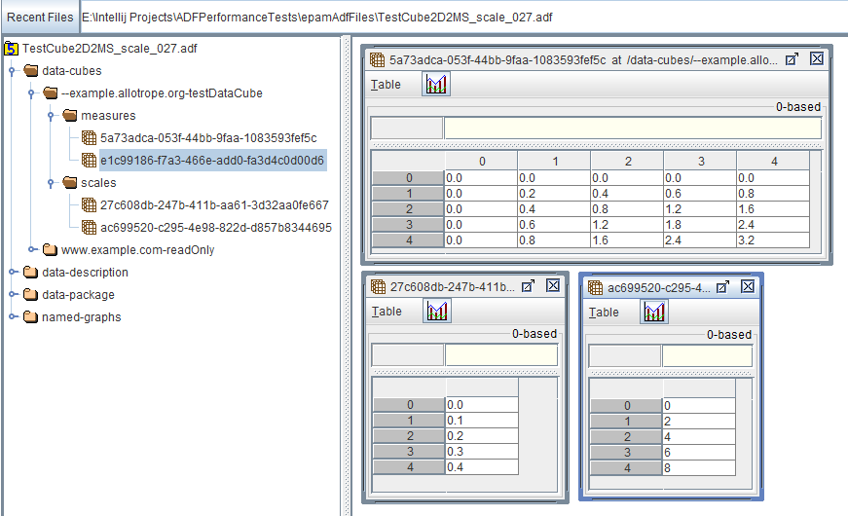
ADF Structure - Data Cubes
Each datacube is an HDF group in ADF
Measures and scales as datasets within the relevant groups for each cube
Metadata about the dimensions are stored in the data description

Slide 21
ADF API - Data Cube
The Framework provides a fluent API for creation of data cubes
Data cube structures can be built once and reused within the same ADF file
Data within DataCube objects are accessed via DataSelections that enable slice/slab pulls
Compression and sparse cubes are supported in the ADF API

Slide 22
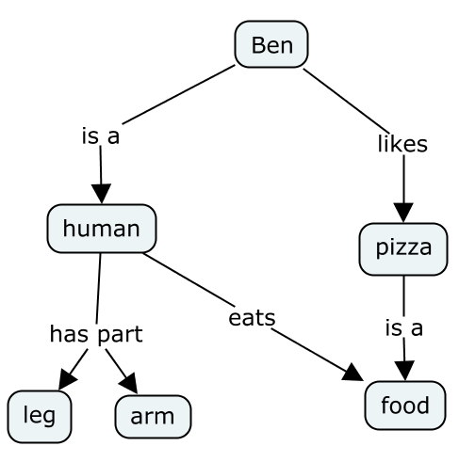
ADF Structure - Data Description
The data description is intended to store experimental metadata in a semantically-enabled form
The typical representation is of facts as triples:
<Subject> <predicate> <object>
<Ben> <is a> <human>
A collection of triples combine to form a graph
Storing multiple distinct graphs in a single dataset converts triples to quads
<Graph> <subject> <predicate> <object>

Slide 23
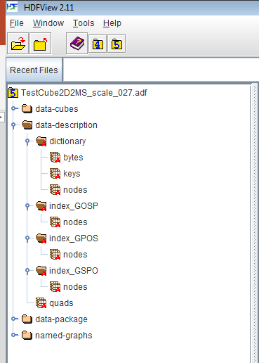
ADF Structure - Data Description
HDF does not yet have native graph storage
ADF emulates this through a combination of:
A dictionary
A list of quads (actually quints, including a deletion flag)
Multiple index listings for fast search

Slide 24
ADF API - Data Description
The Data Description API leverages Apache Jena, a commonly used Semantic Web framework in Java
The DataDescription object implements Jena’s Model interface
Read and write access is available via Jena’s object-oriented API, or by SPARQL queries

Slide 25
ADF Structure – Auxiliary Features
Auxiliary features such as audit trail and named graphs have their own top-level groups
Representations in HDF are identical to the data description

Slide 26
Allotrope Framework – Bringing it all Together
Terms from the Ontologies are used for consistent naming throughout
Ontologies
Allotrope Data Format
API
ADF Explorer
Data Description
Semantic Model
Data Cubes
Universal Data Container
Data Models
Data Package
Virtual file system
The Data Models specify what data is required and how it should be represented, with the correct Ontology terms
ADF stores experimental data in Data Cubes and metadata in the Data Description, conforming to the Data Models
The API ensures consistent usage of the different ADF layers
ADF Explorer visualizes all three layers of ADF
Notes:
The three products combined produce a standard, effective mechanism to store and search scientific data consistently
Also adds semantic meaning to metadata, enabling searches and AI/ML that would not have been possible previously

Slide 27
Allotrope – In pharma today (Agilent)
Agilent have released the first commercial product exporting LCUV data to ADF format
Currently uses an Agilent designed representation for metadata
Will be extended to use the official Allotrope Data Model in a future iteration
Notes:
Agilent were closely involved in creation of the LCUV model so the internal representation is not far off the official model already

Slide 28
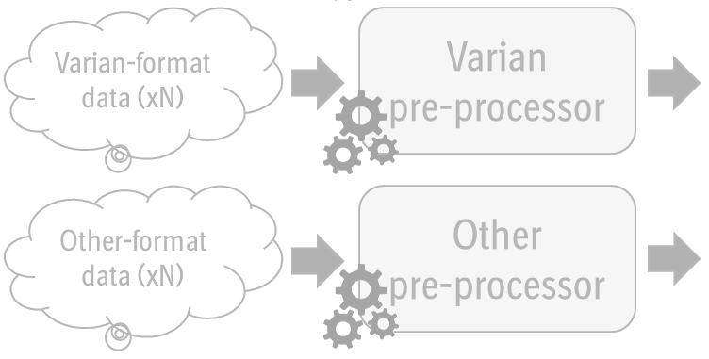
Allotrope - In pharma today (BI)
Boehringer-Ingelheim are using ADF to reduce the number of NMR file formats from 15+ to one…
Bruker-format data (xN)
Bruker
pre-processor
Allotrope
post-processor
Varian-format data (xN)
Varian
pre-processor
.ADF
Consensus Format (CSV)
Other-format data (xN)
Other
pre-processor
Notes:
All 14 Bruker variants identified are being transformed, with 1D, 2D, and 3D+ data all supported.
Plans are underway to convert Varian and other formats of data.
Future work will include “refreshing” the data description with metadata using the proprietary files from the data package layer, in line with the planned NMR data shape.

Slide 29
Allotrope – On the Roadmap
Currently, major work is ongoing in development of the ontologies and data models for new scientific techniques
An overhaul of the ADF API is proposed to resolve some long-term maintenance issues such as dependence on Jena

Slide 30
Allotrope – Vision (GSK)
GSK aims to leverage the Allotrope Framework to enable data integrity throughout the scientific process
Allotrope Ontologies and Data Models enable the vision of a keyboardless lab where common error modes (typos) can be eliminated entirely
Allotrope Data Format provides a high performance, universal storage solution for scientific data and metadata, complete with data integrity checks via the audit trail and checksums
Through partnerships with key vendors, GSK will inform and support development of the next generation of scientific software to realise this vision

Slide 31
Questions?

