Slide 1



The HDF Dataverse
#SC17 Birds of a Feather
Part 1: HDF5 STATE OF THE UNION
State of the Union
    Dave Pearah, CEO, The HDF Group
    Elena Pourmal, Client Management Director and Interim Engineering Director, The HDF Group
    John Mainzer, Principal Architect, The HDF Group
ECP Exascale, Big Data Initiatives
    Quincey Koziol, Principal Data Architect, National Energy Research Scientific Computing Center (NERSC)
Part 2: USER LIGHTING TALKS
    Andreas Dilger, Intel
    Sean Ziegeler, Engility
    Brian van Straalen, Lawrence Berkeley National Laboratory

Slide 2





Who is the HDF Group?
2
“De-facto standard for scientific computing” and integrated into every major scientific analytics + visualization tool
HDF Group has developed open source solutions for Big Data challenges for over 31 years
Small not-for-profit company (~ 40 employees) with focus on High Performance Computing and Scientific Data
Headquarters in Champaign, IL
Our flagship platform – HDF5 – is the heart of our open source ecosystem.
Thousands use + build on HDF5 every day (983 projects on Github)

Slide 3
What does the HDF Group do?
v
HDF5 Community Edition (Open Source)
HDF5 Enterprise Apps: Spark Connector, ODBC Connector, S3 Connector, Compression Library, Binaries, etc.
HDF Cloud (Beta)
Products
v
HDF: new functionality + performance tuning
General HPC software engineering with scientific expertise
Metadata science and standards services
Consulting
v
HDF Support Packages (Basic + Pro + Premier)
Python support for h5py + PyTables + pandas
Training
Support

Slide 4































A few of our users
4

Slide 5
Why Use HDF5?
5
Self-documenting container optimized for scientific data + metadata
I/O library optimized for scale + speed
Users who need both features

Slide 6
Why is this concept so different + useful?
Native support for multidimensional data
Data and metadata in one place => streamlines data lifecycle & pipelines
Portable, no vendor lock-in
Maintains logical view while adapting to storage context
In-memory, over-the-wire, on-disk, parallel FS, object store
Pluggable filter pipeline for compression, checksum, encryption, etc.
High-performance I/O
Large ecosystem

Slide 7

HDF Strategy
7
HDF5 “Database”
Analytics (Python)
Deep Learning
Exploration
HDF5 Enterprise Apps
HDF Cloud
Support
Web service + Object Storage
1 HDF5 file ➔ multiple objects
Data caching
REST API (h5py)
SDK compatibility
Basic
Pro
Premier
Compression
Binaries
S3 Connect
Spark Connect
ODBC Connect
Etc…
Existing HDF5 Users
HDF5 Community Edition
[Open Source + Free + Registration Required]

Slide 8
Vendor Partner Program (1 Year Update)
    Launched last year at SC16
    Key Partner Services
    Optimized and customized HDF solutions for target platforms and technologies: HDF5 binaries, HDF Cloud, Object Storage connectors, etc.
    Support platform vendors and their end users: premium support backed by HDF Group
    Field sales assistance: private-label team that can build custom and semi-custom apps to support your own sales initiatives
    Co-marketing: showcase platform benchmarks (e.g. STAC M3 in Fintech)

Slide 9
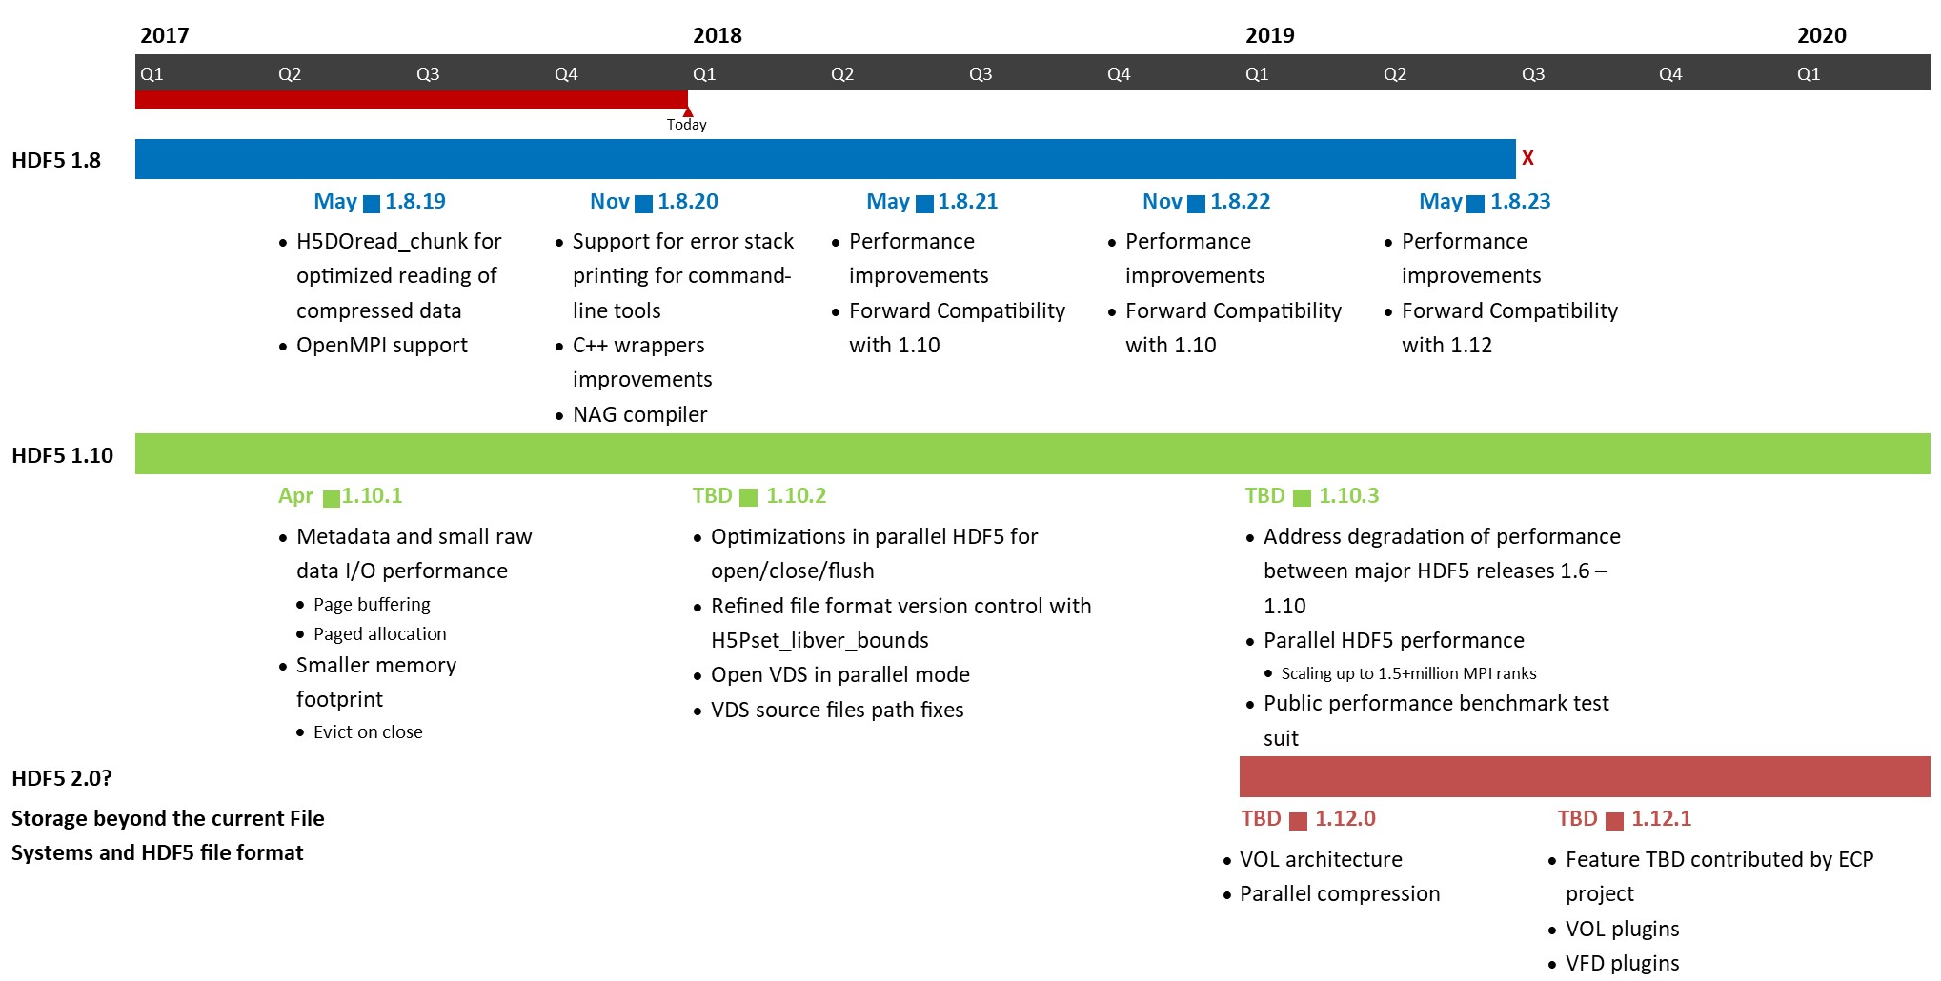
HDF5 Roadmap

Slide 10
Community Involvement
The HDF Group is very grateful for your:
  Participation in releases and features testing
  Issues reporting, improvement suggestions
  Expertise sharing
We accept contributions
  Send your patch (code, test code, documentation changes) to help@hdfgroup.org
We are working on lowering the barrier for contributions
  Public JIRA
  Simplified contribution process
  Developers documentation
  Coding standards

Slide 11
Future HDF5 Enhancements
Storage versatility using VFD and VOL mechanisms
Scalability
  Target 1.5M + MPI ranks
  Use page buffering and metadata paged allocation
Data Model Extensions – possible directions
  Sparse storage
  Key-Value
  Column-Oriented

Slide 12
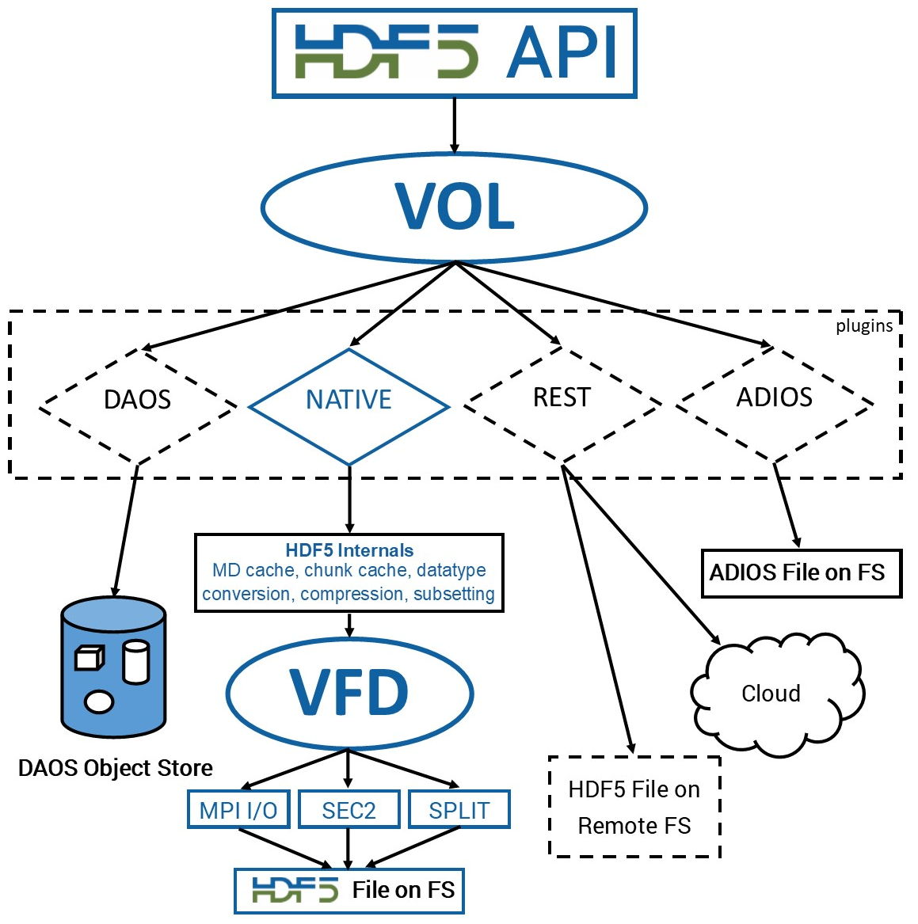
HDF5 Virtual Object Layer (VOL)
Goal
  Provide an application with the HDF5 data model and API, but allow different underlying storage mechanisms
New layer below HDF5 API layer
  Intercepts all API calls that potentially could touch the data on disk and route them to a Virtual Object Driver
Potential Object Drivers (or plugins):
  Native HDF5 driver (writes to HDF5 file)
  Raw driver (maps groups to file system directories and datasets to files in directories)
  Drivers to Object Store (DAOS)
  Remote driver (the file exists on a remote machine)
  Drivers to other file formats (netCDF, HDF4, ADIOS, FITS, etc.)
VOL properties
  Stackable
  Dynamically loaded
Notes:
Items in blue are parts of the current HDF5 library
Plugins (dash lines) are prototyped or under development.

Slide 13
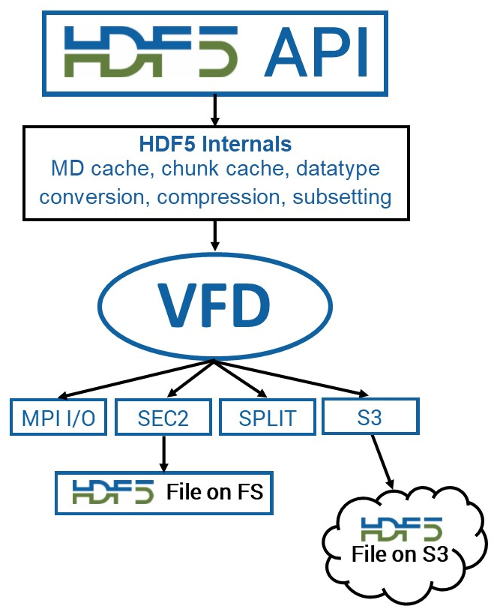
HDF5 S3 VFD
Goal
  Serve HDF5 files from Object Store
Approach
  Use existing HDF5 library and new VFD drivers to access the HDF5 file (work in progress)
  S3 VFD uses range gets to read the desired data from the HDF5 file
  R/O case
    Optimization is performed to avoid small metadata accesses
    Ingestion tool is required to create object with metadata information
  R/W case takes advantage of paged allocation feature introduced in HDF5 1.10.1
    VFD tracks allocations for the pages containing metadata and raw data for an object.

Slide 14
HDF5 Scalability
Goal
  Scale to 1.5+ million MPI ranks
Problem on Lustre
  System contention when performing small I/O (HDF5 metadata and small raw data)
    HDF5 metadata (~ few KB) is scattered all over the file
    A single collective write just before close results in excessive lock contention
    The MPI_File_set_size() call that is made shortly after the above collective metadata write typically cannot execute until it obtains locks on all OSTs. This requires the call to wait until the above contention is resolved – hence the delays we have been seeing on our truncate calls at file close.
Proposed Solution
  Implement paged aggregation and page buffering for parallel HDF5

Slide 15
ExaHDF5 Mission
Work with ECP applications to meet their needs
Productize HDF5 features
Support, maintain, package, and release HDF5
Research toward future architectures and incoming requests from ECP teams

Slide 16

ExaHDF5 Team
PI Name | Affiliation and Project Role
Suren Byna | LBNL, Project Lead
Quincey Koziol | LBNL, Software development lead
Scot Breitenfeld | THG, SW Integration and release lead
Venkat Vishwanath | ANL, Integration and collaboration lead
Preeti Malakar | ANL, Data movement optimization
Staff: Houjun Tang, Bin Dong, Junmin Gu, Jialin Liu, Alex Sim, Paul Coffman, Todd Munson, Jerome Soumagne, Dana Robinson, and John Mainzer

Slide 17
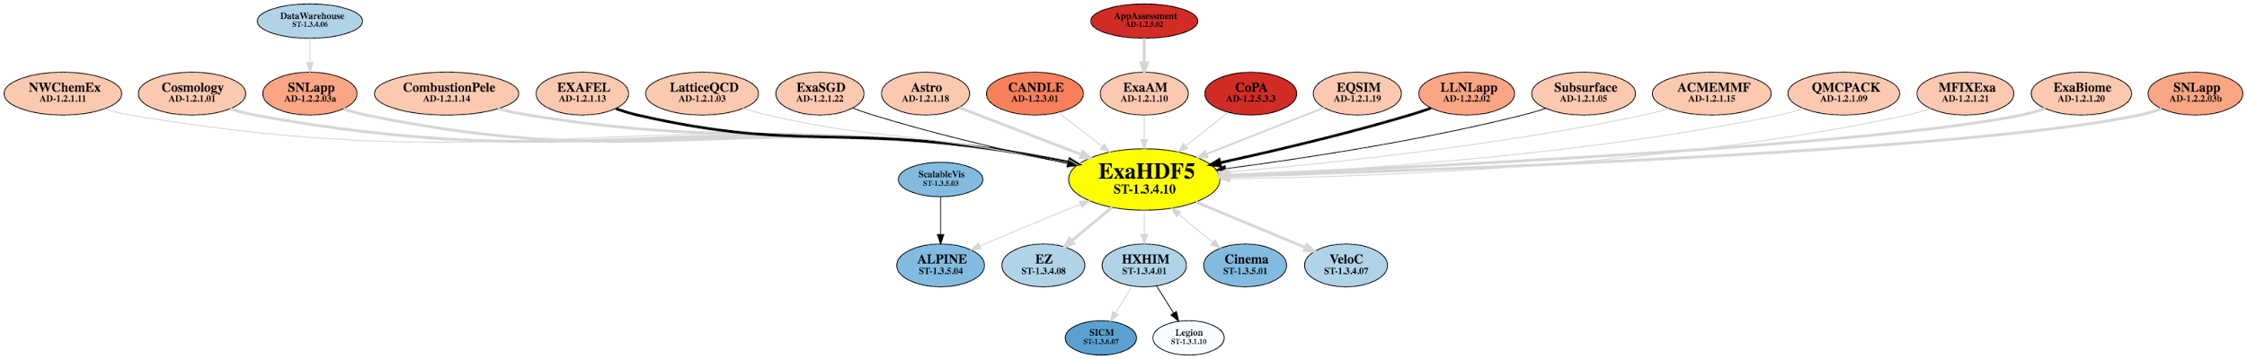
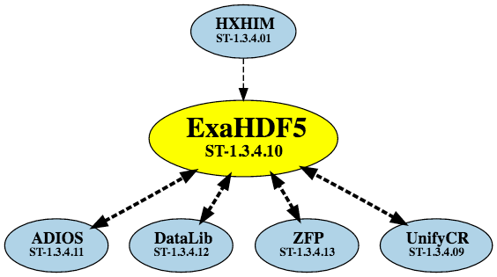
HDF5 in ECP Apps
19 out of the 26 (22 ECP + 4 NNSA) apps currently use or planning to use HDF5
17

Slide 18
Outline
HDF5 features to be developed in ECP ExaHDF5
Timeline
EOD-HDF5 - Features specific for EOD
Looking further ahead
18

Slide 19
ExaHDF5 – Features
Virtual Object Layer (VOL)
  Abstraction layer within HDF5, similar to PMPI layer
  Allows interception of HDF5 calls at runtime, to access data in alternate ways
Caching and prefetching
  Data Elevator for moving data efficiently among storage layers
Topology-aware I/O
  Select data movement optimizations based on topology
  Topology-aware I/O API and HDF5 VOL based on Open Fabrics
Support Advanced Workflows
  Full Single Writer – Multiple Reader (SWMR)
  Design Parallel SWMR
19

Slide 20
ExaHDF5 – Features
Virtual Object Layer (VOL)
  Abstraction layer within HDF5, similar to PMPI layer
  Allows interception of HDF5 calls at runtime, to access data in alternate ways
Caching and prefetching
  Data Elevator for moving data efficiently among storage layers
Topology-aware I/O
  Select data movement optimizations based on topology
  Topology-aware I/O API and HDF5 VOL based on Open Fabrics
Support Advanced Workflows
  Full Single Writer – Multiple Reader (SWMR)
  Design Parallel SWMR
20

Slide 21
Data Elevator
  Contributions
    Low-contention data movement library for hierarchical storage systems
    Offload data movement task to a few compute nodes or cores
    DE intercepts HDF5 calls at run time using VOL
  Benefits of using Data Elevator
    Performance: Have demonstrated that Data Elevator is 4x faster than Cray DataWarp stage_out and 4x faster than writing data to parallel file system, with several science applications on NERSC’s Cori system
    Transparent data movement: Applications using HDF5 specify destination of data file and the Data Elevator transparently moves data from a source to the destination
    Efficiency: Data Elevator reduces contention on BB
    In transit analysis: While data is in a faster storage layer, analysis can be done in the data path
Memory
Node-local storage
Shared burst buffer
Parallel file system
Campaign storage
Archival storage (HPSS tape)
Available on Cori → module load data-elevator

Slide 22
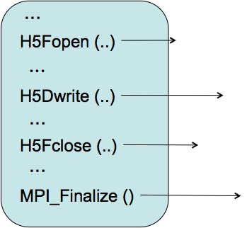


Data Elevator functionality
Start Data Elevator along with an application
DE intercepts HDF5 calls at run time using VOL
Sets up staging area, and give file handle to app
Records the destination in a Berkeley DB table
Writes the data to staging area
Updates the status
Available on Cori → module load data-elevator

Slide 23
ExaHDF5 – Features
Virtual Object Layer (VOL)
  Abstraction layer within HDF5, similar to PMPI layer
  Allows interception of HDF5 calls at runtime, to access data in alternate ways
Caching and prefetching
  Data Elevator for moving data efficiently among storage layers
Topology-aware I/O
  Select data movement optimizations based on topology
  Topology-aware I/O API and HDF5 VOL based on Open Fabrics
Support Advanced Workflows
  Full Single Writer – Multiple Reader (SWMR)
  Design Parallel SWMR

Slide 24
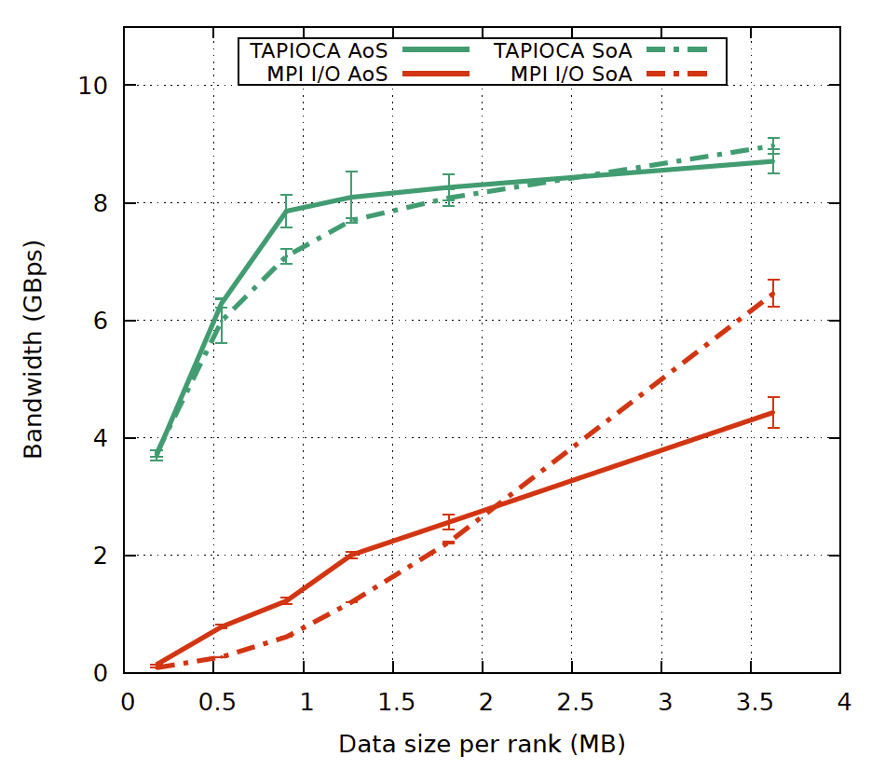
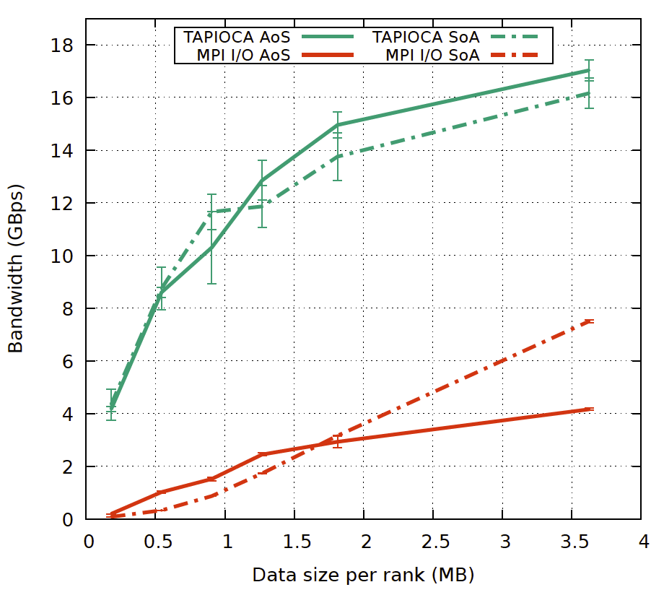
Topology-aware I/O optimizations
Data aggregation algorithm based on the two-phase I/O scheme
  Aggregators placement considering topology and data access pattern
Optimizations:
  Double-buffering
  RMA operation - using non-blocking MPI one-sided communication
1K nodes (16 ranks per node)
F. Tessier, V. Vishwanath, E. Jeannot - TAPIOCA: An I/O Library for Optimized Topology-Aware Data Aggregation on Large-Scale Supercomputers - IEEE Cluster 2017
2K nodes (16 ranks per node)
24

Slide 25
ExaHDF5 – Features
Virtual Object Layer (VOL)
  Abstraction layer within HDF5, similar to PMPI layer
  Allows interception of HDF5 calls at runtime, to access data in alternate ways
Caching and prefetching
  Data Elevator for moving data efficiently among storage layers
Topology-aware I/O
  Select data movement optimizations based on topology
  Topology-aware I/O API and HDF5 VOL based on Open Fabrics
Support Advanced Workflows
  Full Single Writer – Multiple Reader (SWMR)
  Design Parallel SWMR

Slide 26
Full SWMR
Single-Writer / Multiple-Reader (SWMR) allows
  Concurrent access to HDF5 file by a single writing process and many readers
  High-performance, lock-free updates
  Changes to HDF5 files can be streamed to remote locations, enabling super-facility solutions
  Moves HDF5 containers closer to “file system in a file”
  Serial only, currently
    ECP project includes funding for parallel SWMR design though…

Slide 27
ExaHDF5 – Production Features
Asynchronous I/O
  Support for asynchronous I/O operations in HDF5 (serial only)
Independent metadata updates for parallel HDF5
  Metadata updates currently require collective operations
  Break the collective dependencies in updating metadata
Querying HDF5 Files - Data and Metadata
  Basic implementation of querying data is available
  Integrating indexing and querying into HDF5
  Adding metadata querying feature
Interoperability with other file formats
  Capability to read netCDF/PnetCDF and ADIOS files, using VOL

Slide 28
Asynchronous I/O
Asynchronous I/O for HDF5 allows
  Application to queue operations on an HDF5 file, then check back later for completion
  Uses “event set” object that holds many operations, instead of tokens on single operations
    For ease of use and to preserve dependencies
      H5Fopen → H5Gcreate → H5Dcreate → H5Dwrite
  Applications can then overlap compute, communication, and I/O
    The “trifecta” of high-performance computing: use the entire system simultaneously

Slide 29
ExaHDF5 – More Features
Asynchronous I/O
  Support for asynchronous I/O operations in HDF5 (serial only)
Independent metadata updates for parallel HDF5
  Metadata updates currently require collective operations ☹
  Fix the collective dependency in updating metadata ☺
Querying HDF5 Files - Data and Metadata
  Basic implementation of querying data is available
  Integrating indexing and querying into HDF5
  Adding metadata querying feature
Interoperability with other file formats
  Capability to read netCDF/PnetCDF and ADIOS files, using VOL

Slide 30
Independent Metadata Updates
Independent Metadata Updates (IMU) allow any MPI process to modify the structure of an HDF5 file
IMU addresses the “all collective metadata” limit on parallel HDF5 files
  Currently, any operation that modifies metadata in an HDF5 file must be done collectively
Moves even closer to “file system in a file” for HDF5 containers

Slide 31
ExaHDF5 – More Features
Asynchronous I/O
  Support for asynchronous I/O operations in HDF5 (serial only)
Independent metadata updates for parallel HDF5
  Metadata updates currently require collective operations
  Break the collective dependencies in updating metadata
Querying HDF5 Files - Data and Metadata
  Basic implementation of querying data is available
  Integrating indexing and querying into HDF5
  Adding metadata querying feature
Interoperability with other file formats
  Capability to read netCDF/PnetCDF and ADIOS files, using VOL

Slide 32
Querying HDF5 Data and Metadata
Application queries into HDF5 containers:
  Link / attribute name
  Dataspace dimensionality / size
  Datatype choice
  Dataset / attribute element value / range
“Programmatic”, not “text-based”
  e.g. “H5Qdefine(qid, H5Q_LESSTHAN, type_id, &52);”
Pluggable interface for third-party index modules
  Optional, but used to accelerate queries when available / appropriate
Queries return “views”
  Temporary groups in the HDF5 file that contain datasets with the actual query results

Slide 33
ExaHDF5 – More Features
Asynchronous I/O
  Support for asynchronous I/O operations in HDF5 (serial only)
Independent metadata updates for parallel HDF5
  Metadata updates currently require collective operations
  Break the collective dependencies in updating metadata
Querying HDF5 Files - Data and Metadata
  Basic implementation of querying data is available
  Integrating indexing and querying into HDF5
  Adding metadata querying feature
Interoperability with other file formats
  Capability to read netCDF/PnetCDF and ADIOS files, using VOL

Slide 34
Interoperability w/ Other File Formats
Virtual Object Layer (VOL) allows intercepting HDF5 API and accessing data in alternate ways, including other file formats
ExaHDF5 feature enables expanding the HDF5 API to access other file formats
  netCDF/PnetCDF, ADIOS, etc.
Intercept HDF5 Read API calls using VOL
  Redirect the calls to read data from other formats

Slide 35
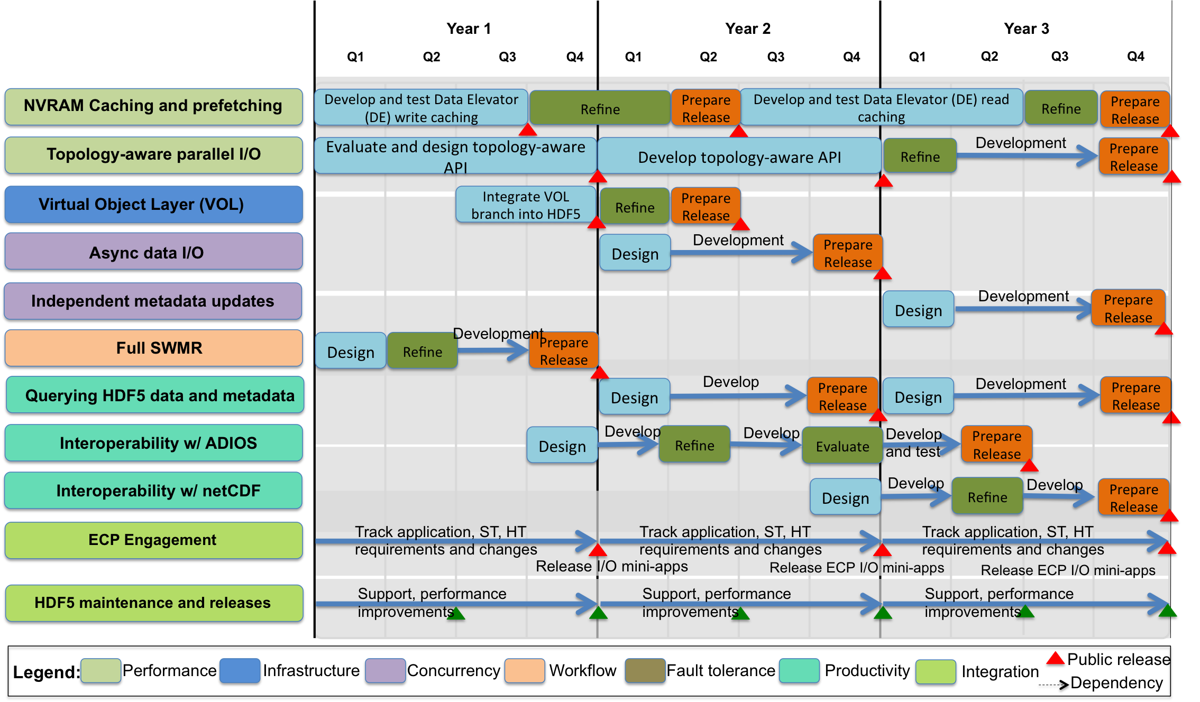
ExaHDF5 – Development timeline

Slide 36
Experimental & Observational Data (EOD) Management Requirements
Experimental and observational science (EOS) facilities have data management requirements beyond existing HDF5 features
Targeted science drivers
  LCLS / LCLS-II, LSST, ALS, NIF
Requirements
  Multiple producers and multiple consumers of data
  Remote streaming synchronization
  Handling changes in data, data types, and data schema
  Search metadata and provenance directly in HDF5 files
  Support for different forms of data - Streaming, sparse, KV, etc.
  Optimal data placement

Slide 37
EOD-HDF5 - Proposed features
Multi-modal access and distributed data in workflows
  Multiple Writers, Multiple Readers (MWMR)
  Distribution of local changes to remote locations
Data model extensions
  Storing new forms of data (KV, index-like data structures, streaming data)
  Addressing science data schema variation
  Managing collections of containers
Metadata and provenance management
  Capturing and storing rich metadata contents and provenance
  Searching metadata and provenance
  Optimal data placement based on data analysis patterns

Slide 38
Future HDF5 Features
Performance improvements for both small and large-scale I/O
  Resource usage profiling in HDF5 to identify bottlenecks
  Automatic bottleneck avoidance techniques
Sub-filing and other topology-aware I/O
  TAPIOCA, etc.
Fill Parallel I/O Gaps
  Parallel Async & SWMR
Enhance storage model
  Column-oriented & Sparse data storage
Track Future Technology Changes
  Object file system VOL plugins (DAOS, Ceph, MarFS, …)

Slide 39
HDF BOF
Andreas Dilger
High Performance Data Division
SC'17, Denver

Slide 40
Composite/Progressive File Layout Lustre 2.10
Composite File Layout allows different layout based on file offset
  Provides flexible layout infrastructure for upcoming features
    Data-on-MDT (DoM), File Level Redundancy (FLR), HDF library integration, etc.
  Layout components can be disjoint (e.g. PFL) or overlapping (e.g. FLR)
Progressive File Layout (PFL) simplifies usage for users and admins
  Optimize performance for diverse users/applications
  One PFL layout could be used for all files
  Low stat overhead for small files
  High IO bandwidth for large files
Example progressive file layout with 3 components
1 stripe [0, 32MB) | 4 stripes [32MB, 1GB) |  |  |  | 128 stripes [1GB, ∞)
SSD |  |  |  |  |  |  |  |  |  |  | …

Slide 41
Tiered Storage and File Level Redundancy
Data locality, with direct access from clients to all storage tiers as needed
Metadata
Targets (MDTs)
Object Storage Targets (OSTs)
(Warm Tier SAS)
Management
Target (MGT)
Archive OSTs/Tape
(Cold Tier Erasure Code)
Object Storage Servers
(~1000’s)
Metadata
Servers (~100’s)
Policy
Engine
NVMe MDTs
client network
Lustre Clients (~50,000+)
NVMe Burst Buffer/Hot Tier OSTs
on client network
Notes:
Lustre sits on top of ldiskFS or ZFS
- ext3 changed into ext4 by the team under Eric Barton / Andreas Dilger
- optimizing ZFS – going well
Lustre was built to handle streaming workloads – C/R
Outline:
2 min intro – Emphasize my new role in Intel
10 min Lustre status, roadmap, highlights
4 min new solid state storage direction
2 min new architecture possibilities
2 min software implications

Slide 42
File Level Redundancy Lustre 2.11+
Significant value and functionality added for HPC and other environments
  Optionally set on a per-file/dir basis - flexibility to tune as application/user needs
  Higher availability for server/network failure – finally better than HA failover
  Robust against data loss/corruption – mirror (and later erasure code) data across OSTs
  Migrate NVM<->SSD<->HDD<->Archive, but allows direct access if needed
Configure redundancy on a per-file or directory basis, for example:
  Pre-stage files to SSD for read/write
  Mirror only 1 of 24 hourly checkpoints
  12+3 erasure code large striped files
  Write to SSD for IOPS, mirror to HDD
Replica 0 - PREFER | SSD OST
Replica 1 - DELAY SYNC | INDEX - SSD | DATA - HDD OSTs
Notes:
Progressive file layouts allow the file layout to be optimized for multiple users at the same time. Low overhead for small files, high bandwidth and storage capacity for large files. It can be leveraged by storage libraries like HDF to provide optimized storage layouts for different classes of data within a single file. The work being done to implement PFL leads naturally into File Level Replication, which will unlock a significant amount of value for the Lustre ecosystem. While it could be used in a simple form to replicate all files like Hadoop, it can also be tuned on a per-file basis to optimize performance vs. availability for each user's data and applications. Replicas can be stored in different storage tiers such as flash and disk to reduce latency, or replicated across hundreds of servers for files that are read by thousands of clients.

Slide 43
FLR Phased Implementation Approach
Can implement Phases 2/3/4 in any order
Phase 0: Composite Layouts from PFL project Lustre 2.10
  Plus OST pool inheritance, Project/Pool Quotas
Phase 1: Delayed read-only mirroring – depends on Phase 0 Lustre 2.11
  Manually replicate and migrate files across multiple tiers
Phase 2: Integration with policy engine/copytool - with/after Phase 1
  Automated migration between tiers based on admin policy/space
Phase 3: Immediate write replication – depends on Phase 1 Lustre 2.12?
  Client writes file data to multiple OSTs in parallel
Phase 4: Erasure coding for striped files - with/after Phase Lustre2.12?
  Avoid 2x or 3x overhead of mirroring files
Notes:
Progressive file layouts allow the file layout to be optimized for multiple users at the same time. Low overhead for small files, high bandwidth and storage capacity for large files. It can be leveraged by storage libraries like HDF to provide optimized storage layouts for different classes of data within a single file. The work being done to implement PFL leads naturally into File Level Replication, which will unlock a significant amount of value for the Lustre ecosystem. While it could be used in a simple form to replicate all files like Hadoop, it can also be tuned on a per-file basis to optimize performance vs. availability for each user's data and applications. Replicas can be stored in different storage tiers such as flash and disk to reduce latency, or replicated across hundreds of servers for files that are read by thousands of clients.

Slide 44
Legal Notices and Disclaimers
INFORMATION IN THIS DOCUMENT IS PROVIDED IN CONNECTION WITH INTEL® PRODUCTS. EXCEPT AS PROVIDED IN INTEL’S TERMS AND CONDITIONS OF SALE FOR SUCH PRODUCTS, INTEL ASSUMES NO LIABILITY WHATSOEVER, AND INTEL DISCLAIMS ANY EXPRESS OR IMPLIED WARRANTY RELATING TO SALE AND/OR USE OF INTEL PRODUCTS, INCLUDING LIABILITY OR WARRANTIES RELATING TO FITNESS FOR A PARTICULAR PURPOSE, MERCHANTABILITY, OR INFRINGEMENT OF ANY PATENT, COPYRIGHT, OR OTHER INTELLECTUAL PROPERTY RIGHT. Intel products are not intended for use in medical, life-saving, life-sustaining, critical control or safety systems, or in nuclear facility applications.
Intel products may contain design defects or errors known as errata which may cause the product to deviate from published specifications. Current characterized errata are available on request.
This document may contain information on products in the design phase of development. The information herein is subject to change without notice. Do not finalize a design with this information. Intel may make changes to dates, specifications, product descriptions, and plans referenced in this document at any time, without notice. Designers must not rely on the absence or characteristics of any features or instructions marked "reserved" or "undefined." Intel reserves these for future definition and shall have no responsibility whatsoever for conflicts or incompatibilities arising from future changes to them.
Intel technologies’ features and benefits depend on system configuration and may require enabled hardware, software or service activation. Learn more at intel.com, or from the OEM or retailer.
No computer system can be absolutely secure.
Intel Corporation or its subsidiaries in the United States and other countries may have patents or pending patent applications, trademarks, copyrights, or other intellectual property rights that relate to the presented subject matter. The furnishing of documents and other materials and information does not provide any license, express or implied, by estoppel or otherwise, to any such patents, trademarks, copyrights, or other intellectual property rights.
Performance estimates or simulated results based on internal Intel analysis or architecture simulation or modeling are provided to you for informational purposes. Any differences in your system hardware, software or configuration may affect your actual performance.
Performance tests and ratings are measured using specific computer systems and/or components and reflect the approximate performance of Intel products as measured by those tests. Any difference in system hardware or software design or configuration may affect actual performance. Buyers should consult other sources of information to evaluate the performance of systems or components they are considering purchasing. For more complete information about performance and benchmark results, visit www.intel.com/benchmarks.
Intel does not control or audit third-party benchmark data or the web sites referenced in this document. You should visit the referenced web site and confirm whether referenced data are accurate.
Optimization Notice: Intel's compilers may or may not optimize to the same degree for non-Intel microprocessors for optimizations that are not unique to Intel microprocessors. These optimizations include SSE2, SSE3, and SSSE3 instruction sets and other optimizations. Intel does not guarantee the availability, functionality, or effectiveness of any optimization on microprocessors not manufactured by Intel. Microprocessor-dependent optimizations in this product are intended for use with Intel microprocessors. Certain optimizations not specific to Intel microarchitecture are reserved for Intel microprocessors. Please refer to the applicable product User and Reference Guides for more information regarding the specific instruction sets covered by this notice. Notice Revision #20110804.
Intel® Advanced Vector Extensions (Intel® AVX)* provides higher throughput to certain processor operations. Due to varying processor power characteristics, utilizing AVX instructions may cause a) some parts to operate at less than the rated frequency and b) some parts with Intel® Turbo Boost Technology 2.0 to not achieve any or maximum turbo frequencies. Performance varies depending on hardware, software, and system configuration and you can learn more at http://www.intel.com/go/turbo.
Intel processors of the same SKU may vary in frequency or power as a result of natural variability in the production process.
Intel, the Intel logo, 3D-Xpoint, Optane, Xeon Phi, and Xeon are trademarks or registered trademarks of Intel Corporation or its subsidiaries in the United States and other countries.
* Other names and brands may be claimed as the property of others.
Copyright © 2017 Intel Corporation. All rights reserved.

Slide 46
Experiences with HDF5:
I/O Mini-apps, Compression
& Physics-based Simulations
User Productivity Enhancement,
Technology Transfer, and Training (PETTT)
Presented by
Sean Ziegeler (Engility PETTT)
November 15, 2017

Slide 47
Topics
MiniIO: I/O Mini-apps
Compression Study
  Results
HDF5 Autotuner Results
How/Why HDF5
What do we need from HDF5?
Notes:
OSR Case No. 13-S-1220

Slide 48
MiniIO: I/O Mini-apps
MPI, no threads (yet, but can be simulated with fewer ranks per node)
Four apps for now, common physics-based HPC simulation data structures
  All are interesting use cases for compression, but here we focus on one
MPI-IO, ADIOS, & HDF5 output options
Built explicitly around physics-based code options
  Not extracted code kernels or emulators, as per, e.g., skel or MACSio or general I/O benchmarks like IOR
  Why not? (1) Skel only for ADIOS; MACSio had not been published yet
  Why not? (2) MiniIO provides numerous physics-based simulation options (grid settings, load balancing, variable settings …) that can be directly mapped to performance
  IOR or MACSio could work in the long run, but we would need to ensure all MiniIO features mapped properly to them
Notes:
OSR Case No. 13-S-1220

Slide 49
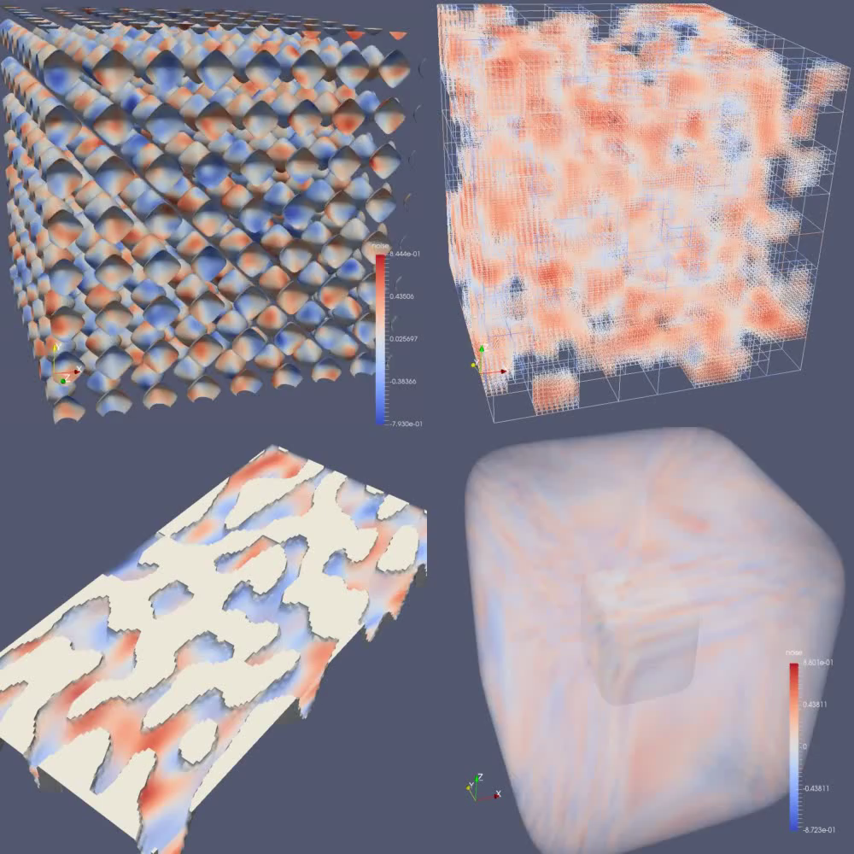
MiniIO: I/O Mini-apps
”Cartiso”
”AMR”
”Struct”
”Unstruct”
Notes:
OSR Case No. 13-S-1220

Slide 50
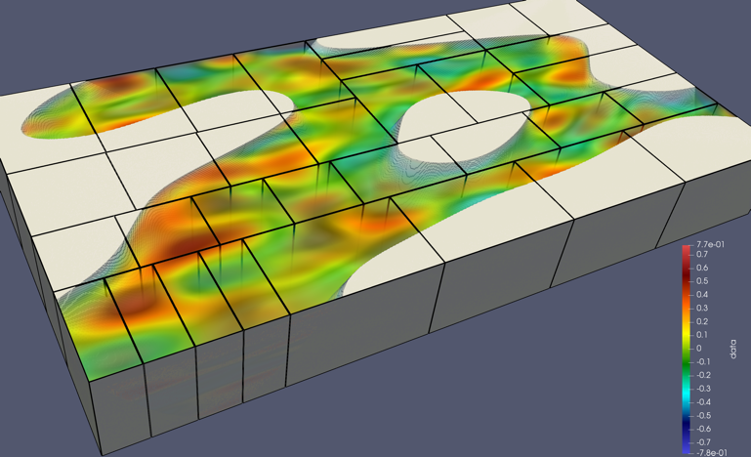
Struct Mini-app
Struct: structured grids with masks/blanking
  Masks for missing or invalid data (e.g. land in an ocean model)
    2D simplectic noise to generate synthetic mask maps
    Can choose % of blanked data points
    Noise frequency governs sizes of blanked areas (continents vs islands)
  4D simplectic noise to fill time-variant variables
  Option for load balancing non-masked points evenly (as desired) across ranks
    But creates load imbalance
    for I/O because blanked data
    is still written
    Compression theoretically
    rebalances the I/O (blanked
    constants compress well)
Notes:
OSR Case No. 13-S-1220

Slide 51
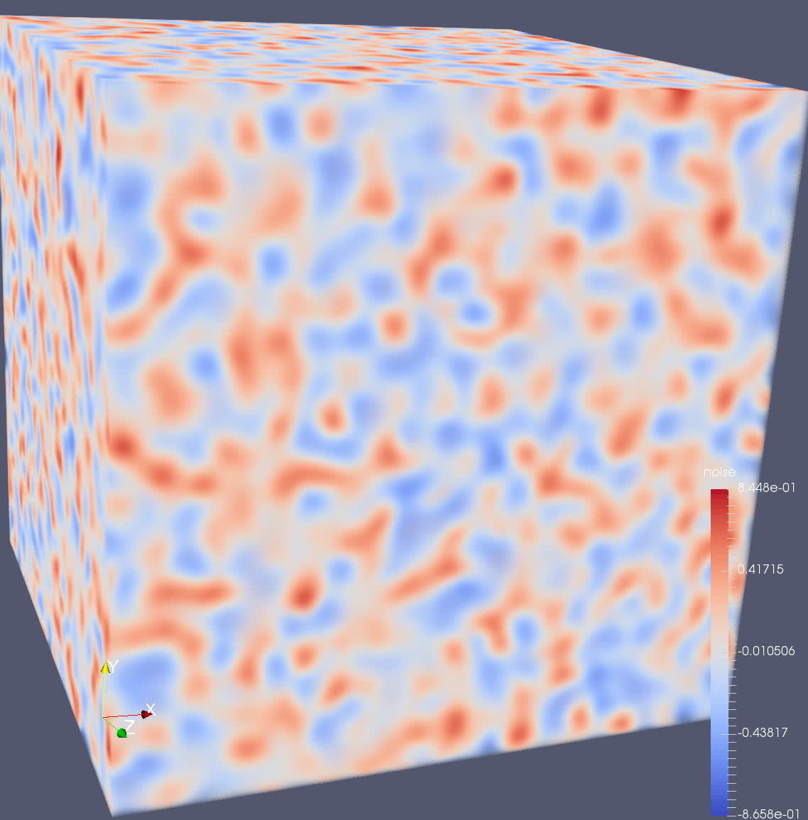
4D Simplectic Noise & Compression
Rendering of a volume
of simplectic noise
Compression results of simplectic noise
at various frequencies
Notes:
OSR Case No. 13-S-1220

Slide 52
Results
ADIOS POSIX: one file per rank
Computationally
unbalanced
Balanced (I/O unbalanced!)
Red: No compression
Blue: zlib deflate compression (think gzip)
Green: szip compression
Purple: zfp (error bounded lossy, 0.0001), ~9:1 on average
Notes:
OSR Case No. 13-S-1220

Slide 53
Results
ADIOS POSIX: one file per rank
Initial scalability with core count
Computational balancing hurts performance a little
  But compression sometimes helps
Zfp is the fastest compression
KNL is slower
ADIOS POSIX is the fastest without compression
Notes:
OSR Case No. 13-S-1220

Slide 54
Results
ADIOS MPI-Lustre: one file for all ranks, tuned for Lustre file system on that system
Good scalability with core count, especially with compression
Computational balancing hurts performance a little
  But compression mostly helps
Zfp is by far the fastest compression
KNL is much slower, especially the compression
MPI-Lustre is the fastest with compression
Notes:
OSR Case No. 13-S-1220

Slide 55
Results
HDF5: one file for all ranks
Starts slower, but scalability with core count, especially with compression
Computational balancing hurts performance a lot
  But compression helps somewhat
Shuffle+zlib is the fastest compression (zfp not available at the time)
KNL is much slower, especially the compression
HDF5 can scale with compression
Notes:
OSR Case No. 13-S-1220

Slide 56
HDF5 Autotuner Results
Notes:
OSR Case No. 13-S-1220

Slide 57
How/Why do we use HDF5?
The most standardized format
  Can find some way to use HDF5 in Ensight, VisIt, ParaView …
  The primary underlying format for the CGNS standard
  Also via netCDF-4 (built atop HDF5)
Yet more flexible than other formats
  Hierarchies, non-structured data, analytics with binary data
  Weirdness is usually at odds with standardization
Already installed on most of our systems
Compression and other filters
Emerging features like Virtual Data Sets (VDS)
Notes:
OSR Case No. 13-S-1220

Slide 58
What do we need from HDF5?
Continued improvements to parallel performance
  Ensure that transitions to netCDF
Smarter handling of parallel file systems
  Very difficult for users to set stripe counts, stripe sizes, collective buffering
  Autotuner is helpful but difficult to use
  Potentially integrate into the library
Zfp with HDF5
  Transition to netCDF
VDS for parallel I/O
  Very promising approach to transcend single-file limitations
  Transition to netCDF
Notes:
OSR Case No. 13-S-1220

Slide 59
This material is based upon work supported by,
or in part by, the Department of Defense
High Performance Computing Modernization Program (HPCMP)
under User Productivity, Technology Transfer and Training (PETTT) contract number GS04T09DBC0017.
DISTRIBUTION STATEMENT A. Approved for public release. Distribution is unlimited.

Slide 60
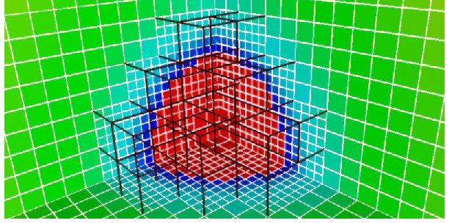
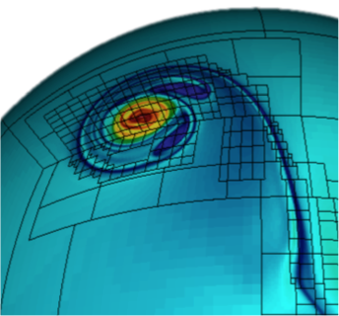
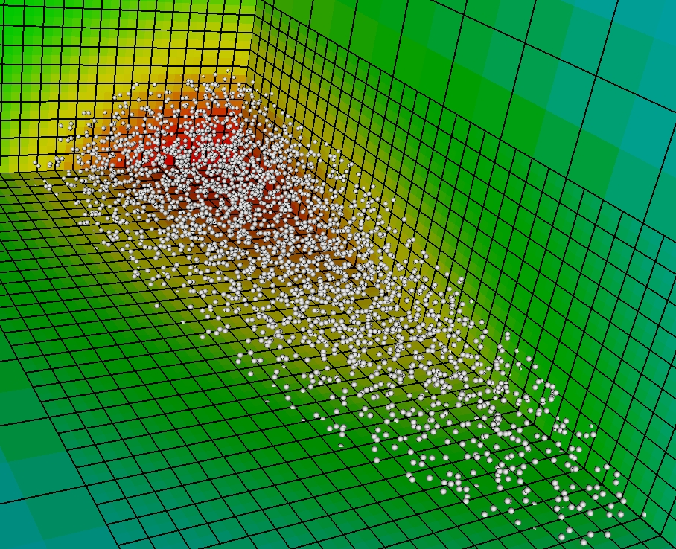
Block-Structured Adaptive Mesh Refinement (AMR)
Refined regions are organized into rectangular patches.
Refinement in time as well as in space for time-dependent problems.
Local refinement can be applied to any structured-grid data, such as bin-sorted particles.

Slide 61
Chombo and HDF5
HDF5 is our primary IO Middleware on all platforms
  Portable plot and checkpoint files
  Reader for Visit
  Parallel IO with hyperslabs (using our own global variable ordering)
New roles
  Code coupling between Chombo (structured AMR) and GEOS (unstructured FEM)
  Asynchronous workflow through NVRAM technologies

Slide 62
Wish List
warning: 'tmpnam' is deprecated
  Need temporary file creation mechanism
  Workflow, using HDF5 in debugger
Code coupling without requiring disk
  RAM to RAM transfer in MPI jobs (ie pipe)
  Possibly with disk backing
DataMover (asynchronous data migration, workflow)
FArrayBox to “Object Store”
  Tag FArrayBox with [time,level,index] key, receive future
FASTBit
Aggregated IO handled for me
Set Lustre file system parameters for me.

