Slide 1
A Brief Introduction to HDF5
Quincey Koziol
Director of Core Software and HPC
The HDF Group
koziol@hdfgroup.org
http://bit.ly/HDF5-HPCOGW-2015

Slide 2
Why use HDF5?
Challenging Data:
  Application data that pushes the limits of traditional solutions.
Software Solutions:
  For very large and/or complex data
  With very fast access requirements
  Easily share data across a platforms
  Use different programming languages and OSs.
  Take advantage of the tools that understand HDF5.
  Enable long-term preservation of data.
http://bit.ly/HDF5-HPCOGW-2015

Slide 3
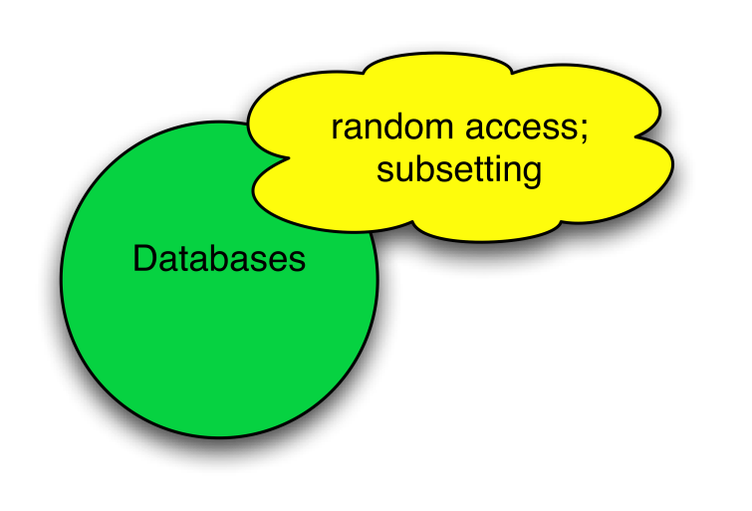
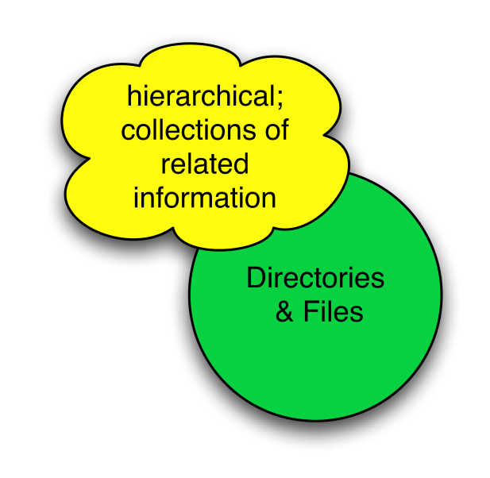
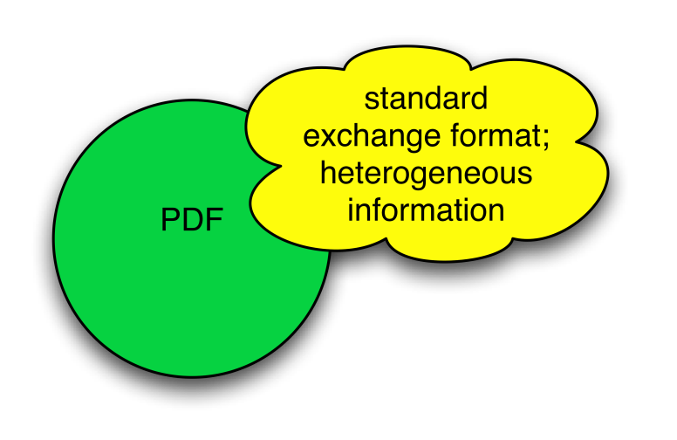
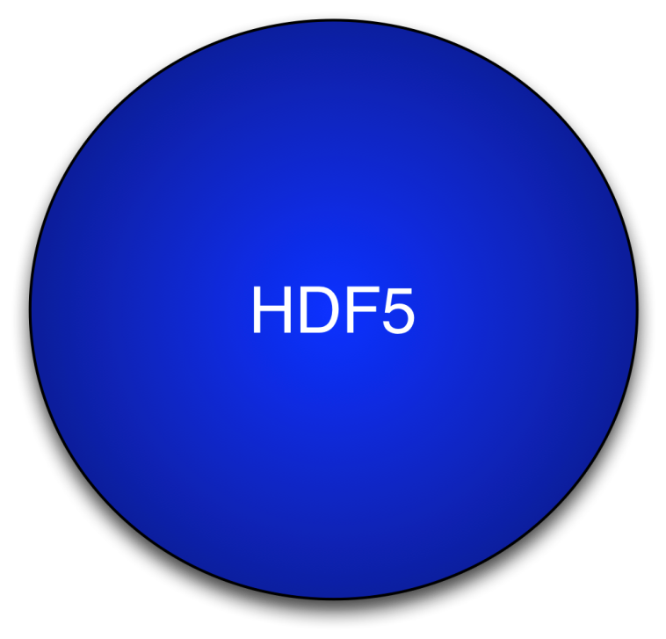
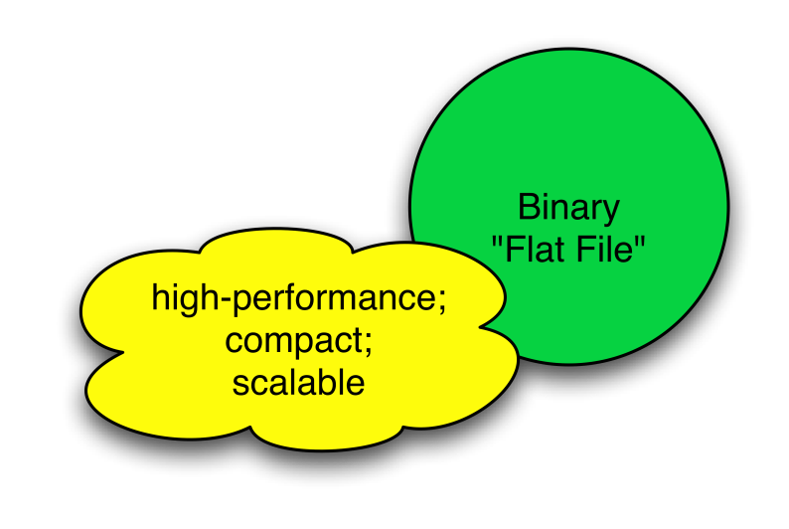
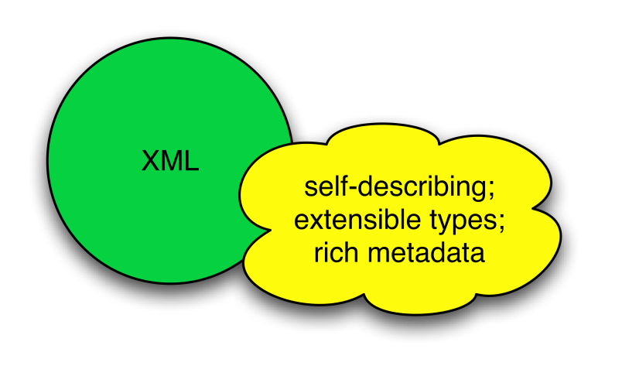
HDF5 is like …

Slide 4
What is HDF5?
HDF5 == Hierarchical Data Format, v5
A flexible data model
  Structures for data organization and specification
Open source software
  Implements the data model
Portable file format
  Designed for high volume or complex data

Slide 5
HDF5 Data Model
Groups – provide structure among objects
Datasets – where the primary data goes
  Data arrays
  Rich set of datatype options
  Flexible, efficient storage and I/O
Attributes - for metadata
Everything else is built essentially from these parts.

Slide 6
HDF5 Software
HDF5 home page:
http://hdfgroup.org/HDF5/

Slide 7
Useful Tools For New Users
h5dump, h5ls:
Tools to “dump” or list contents of HDF5 file
HDFView:
Java browser for HDF5 files
http://www.hdfgroup.org/hdf-java-html/hdfview/
HDF5 Examples (C, Fortran, Java, Python, Matlab)
http://www.hdfgroup.org/ftp/HDF5/examples/
h5cc, h5c++, h5fc:
Scripts to compile applications

Slide 8
Recent HPC Success Story
Performance results on Blue Waters @ NCSA
  I/O Kernel of a DOE Plasma Physics application
Running on 298,048 cores
  ~10 Trillion particles
  Single 291TB HDF5 file
  Achieved 52 GB/s
    ~50% of the peak performance
    Using 1 GB stripe size and 160 Lustre OSTs

Slide 9
HDF5 in Oil & Gas
REMSQL: Standard for reservoir data (Energistics)
  http://www.energistics.org/reservoir/resqml-standards/current-standards
H5EM-TS: Exchange standard for field EM data (EMGS, Statoil, Interaction)
  ftp://fileformats.emgs.com/H5EM-TS_1.0/documentation/H5EM-TS_information_sheet.pdf

Slide 10
HDF5 in Oil & Gas
TEMHDF: Exchange standard for MetalMapper and other EMI data
  ftp://geom.geometrics.com/pub/Data/TEM2H5_Deliverables/TEM2HDF_RefManual.pdf
PH5: Archival format for active source seismic data (moving away from SEG-Y, to HDF5)
  http://www.passcal.nmt.edu/content/ph5-what-it
Petrel: E&P Workflow and Visualization
  http://www.software.slb.com/products/platform/Pages/petrel.aspx

Slide 11
HDF5 in Oil & Gas
Globe Claritas: HDF5 is format for their seismic processing software
  SEG-Y vs. HDF5 Whitepaper: http://www.globeclaritas.com/content/download/10303/55223/file/HDF5%20For%20Seismic%20Reflection%20Datasets.pdf
  News release: http://www.globeclaritas.com/Claritas/Overview/Latest-Release
  PDF data sheet: http://www.globeclaritas.com/content/download/8839/47774/file/Claritas%20HDF5.pdf
  Powerpoint: http://www.slideshare.net/guy_maslen/a-quick-start-guide-to-using-hdf5-in-globe-claritas

Slide 12
Where We’ll Be Soon: HDF5 1.10
Beta release: Fall 2015
Major Features:
  Single-Writer/Multiple-Reader (SWMR)
  Virtual Datasets
  Improved scalability of chunked datasets
  Parallel I/O performance and capabilities

Slide 13
Other Items of Interest
We’re not planning to change current multi-threaded concurrency behavior
HDF5 Excel Add-in: HEXAD
REST-based service for HDF5 data
HDF Compass visualization package

Slide 14
Thank You!
Questions & Comments?
http://bit.ly/HDF5-HPCOGW-2015

Slide 15
The HDF Group Services
Helpdesk and Mailing Lists
  Available to all users as a first level of support: help@hdfgroup.org, hdf-forum@lists.hdfgroup.org
Priority Support
  Rapid issue resolution and advice
Consulting
  Needs assessment, troubleshooting, design reviews, etc.
Training
  Tutorials and hands-on practical experience
Enterprise Support
  Coordinate HDF activities across departments
Special Projects
  Adapting customer applications to HDF
  New features and tools
  Research and Development
http://bit.ly/HDF5-HPCOGW-2015

Slide 16
HDF5 1.10 Planned Features: SWMR
Improves HDF5 for Data Acquisition:
  Allows simultaneous data gathering and monitoring/analysis
  Focused on storing data sequences for high-speed data sources
Supports ‘Ordered Updates’ to file:
  Crash-proofs accessing HDF5 file
  Possibly uses small amount of extra space

Slide 17
HDF5 1.10 Planned Features
Virtual Object Layer (VOL)
  Provides the HDF5 data model and API, but allows different underlying storage mechanisms
  Intercepts all HDF5 API calls that can touch the data on disk and routes them to a VOL plugin
    Possibly SEG-Y VOL plugin?

Slide 18
HDF5 1.10 Planned Features
‘Virtual’ Datasets
  Can “stitch together” multiple ‘source’ datasets into a single ‘virtual’ dataset
  Supports unlimited dimensions in both source and virtual datasets

Slide 19
HDF5 1.10 Planned Features: Chunk Imp.
Dataset type | Index type | Space improvements | Speed improvements
no unlimited dimensions, no I/O filters, no missing chunks | “implicit” no actual chunk index | Same storage space as contiguous dataset storage (no index) | Constant time lookups Faster parallel I/O
no unlimited dimensions | “fixed sized” smaller chunk index | Smaller index overhead | Constant time lookups
1 unlimited dimension | “extensible array” | Smaller index overhead | Constant time lookups and appends
2+ unlimited dimension | Improved B-tree* | Smaller index overhead | Faster

Slide 20
HDF5 1.10 Planned Features: HPC
Continue to improve our use of MPI and parallel file system features
  Remove ‘truncate’ operation on file close, etc.
Reduce # of I/O accesses for metadata access
  Collective Read/Write of metadata
  Multi-dataset Collective I/O
  Support for compression in parallel
  Collective access mode only
Possibly Support Single-Write/Multiple-Reader (SWMR) access in parallel

Slide 21
HDF5 Roadmap
Concurrency
  Single-Writer/Multiple-Reader (SWMR)
  Internal threading
Virtual Object Layer (VOL)
Data Analysis
  Query / View / Index APIs
Native HDF5 client/server
Performance
  Scalable chunk indices
  Metadata aggregation and Page buffering
  Asynchronous I/O
  Variable-length records
Fault tolerance
Parallel I/O
I/O Autotuning
“The best way to predict the future is to invent it.”
– Alan Kay
HPC Oil & Gas Workshop

Slide 22
Where We’re Not Going
We’re not changing multi-threaded concurrency support
  Keep “global lock” on library
  Will focus on asynchronous I/O instead
  Will be using threads internally though

Slide 23

Codename “HEXAD”
HDF5 Excel Add-in: HEXAD
Lets you do the usual things including:
  Display content (file structure, detailed object info)
  Create/read/write datasets
  Create/read/update attributes
Plenty of ideas for bells & whistles
  HDF5 Image & PyTables support, etc.
Send in your Must Have/Nice To Have list!*
Stay tuned for the beta program
* help@hdfgroup.org

Slide 24

HDF Server
REST-based service for HDF5 data
Reference Implementation for REST API
Developed in Python using Tornado Framework
Supports Read/Write operations
Clients can be Python/C/Fortran or Web Page
Let us know what specific features you’d like to see.

Slide 25
HDF Compass
“Simple” Python HDF5 Viewer application
Cross platform (Windows/Mac/Linux)
Native look and feel
Can display extremely large HDF5 files
View HDF5 files and OpenDAP resources
Plugin model enables different file formats/remote resources to be supported
Community-based development model

Slide 26




Brief History of HDF
1987 At NCSA (University of Illinois), forms task force to create an architecture-independent file format and library, which becomes HDF
Early NASA adopts HDF for Earth Observing System project
1990’s
1996 DOE collaborates with the HDF group (at NCSA) to
create “Big HDF” which becomes HDF5
1998 HDF5 released, with support from DOE, NASA & NCSA
2006 The HDF Group spins out of University of Illinois as non-profit corporation

Slide 27
The HDF Group
Established in 1988
  18 years at University of Illinois’ National Center for Supercomputing Applications
  8 years as independent non-profit company:
    “The HDF Group”
The HDF Group owns HDF4 and HDF5
  HDF4 & HDF5 formats, libraries, and tools are open source and freely available with BSD-style license

